Slide 1


Unit - 2
Data Science for Applied Sciences

Slide 2
Chapters for Discussion
Chapter - 1
Data Science for Applied Sciences
Chapter - 2
Data Visualization using MS Excel
Chapter - 3
Introduction to Python
Chapter - 4
Data Manipulation and Analysis - Working with Data

Slide 3

Chapter
Data Science for Applied Sciences
1
Notes:
Dear Students, In today's session we are going to learn about Python.

Slide 4
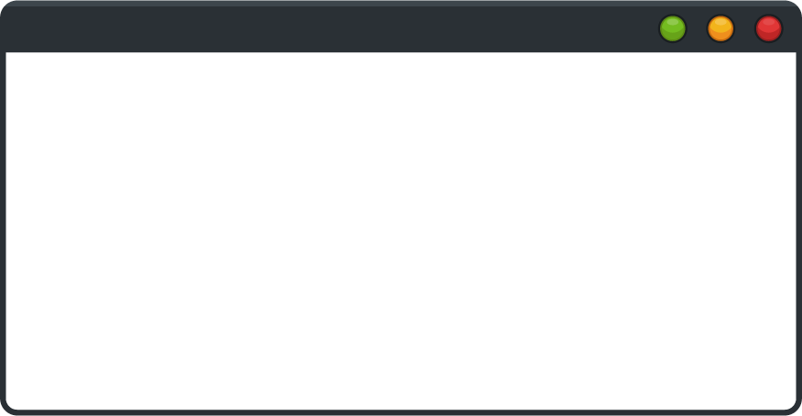

DISCLAIMER
The content is curated from online/offline resources and used for educational purpose only.

Slide 5

Learning Objectives
Create line, bar, pie, and scatter charts in Excel to effectively visualize data trends, comparisons, proportions, and relationships.
Apply customization techniques such as adding titles, labels, and legends, and adjusting styles to enhance chart clarity and visual impact.
Utilize Excel's data visualization tools to support data analysis and communicate insights effectively.
Define Python and identify its key features and advantages.
Recall the steps required for Python installation and setting up a development environment.
Describe the purpose of variables and different data types (integers, floats, strings, booleans).
Describe functions, including lambda functions, and their use in Python.
Create and use custom functions to organize code.
Create a basic class with attributes and methods.
Identify attributes as variables belonging to a class or object.
GOAL
Notes:
Learning Objectives
Create line, bar, pie, and scatter charts in Excel to effectively visualize data trends, comparisons, proportions, and relationships.
Apply customization techniques such as adding titles, labels, and legends, and adjusting styles to enhance chart clarity and visual impact.
Utilize Excel's data visualization tools to support data analysis and communicate insights effectively.
Define Python and identify its key features and advantages.
Recall the steps required for Python installation and setting up a development environment.
Describe the purpose of variables and different data types (integers, floats, strings, booleans).
Describe functions, including lambda functions, and their use in Python.
Create and use custom functions to organize code.
Create a basic class with attributes and methods.
Identify attributes as variables belonging to a class or object.

Slide 6
Learning Objectives
Create and call methods within a class to perform actions on object data.
Describe inheritance as a way to create a new class from an existing class.
Explain encapsulation as bundling data and methods within a class and restricting access.
Describe polymorphism and its purpose in using a common interface for different forms.
Identify the purpose of Pandas for data manipulation with data frames and series.
Recognize NumPy as a library for handling arrays and numerical data.
Explain common techniques for handling missing values and preparing data for analysis.
Describe the function of Matplotlib in creating visualizations like plots and charts.
Explain Seaborn’s role in creating advanced visualizations and statistical plots.
GOAL
Notes:
Learning Objectives
Create and call methods within a class to perform actions on object data.
Describe inheritance as a way to create a new class from an existing class.
Explain encapsulation as bundling data and methods within a class and restricting access.
Describe polymorphism and its purpose in using a common interface for different forms.
Identify the purpose of Pandas for data manipulation with data frames and series.
Recognize NumPy as a library for handling arrays and numerical data.
Explain common techniques for handling missing values and preparing data for analysis.
Describe the function of Matplotlib in creating visualizations like plots and charts.
Explain Seaborn’s role in creating advanced visualizations and statistical plots.

Slide 7
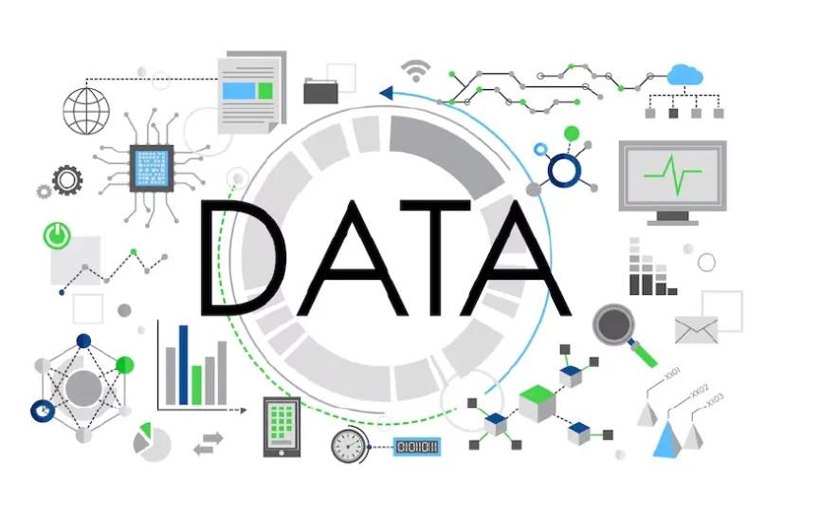
What is Data?
Data refers to information that is collected, processed, and analyzed to help us understand the world, make decisions, and solve problems.
It can come in various forms and can represent anything: numbers, text, images, sounds, and more.
Data is the foundational element that powers fields like science, technology, business, and education, enabling better insights and predictions.
Source :
https://herovired.com/learning-hub/blogs/what-is-data/
Notes:
What is Data?
Since the invention of computers, people have used the term data to refer to computer information, and this information was either transmitted or stored. But that is not the only data definition; there exist other types of data as well.
So, what is the data? Data can be texts or numbers written on papers, or it can be bytes and bits inside the memory of electronic devices, or it could be facts that are stored inside a person’s mind.
Data, at its core, is any set of values or details that provide information about something. When we say "data," we're talking about information that can be observed, measured, recorded, and used to understand different aspects of the world. It's not limited to a single form; it can be as straightforward as numbers in a spreadsheet or as complex as the pixels in an image, the sound waves of music, or the words of a book. Data's versatility and potential to represent almost anything are what make it so powerful and universally applicable.

Slide 8
Types of Data
Broadly, data in data science is classified into several types:
Qualitative (Categorical) Data: Non-numeric data that represents categories or labels.
Quantitative (Numerical) Data: Numeric data that quantifies quantities.
Structured Data: Highly organized data stored in a tabular format.
Unstructured Data: Raw, unorganized data without a predefined format.
Time-Series Data: Data points indexed in time order, often used for analyzing trends over intervals.
Spatial Data: Data associated with physical locations, useful for mapping and geographic analyses.
Notes:
Qualitative (Categorical) Data
This type of data describes qualities or characteristics and is non-numerical. Qualitative data is often divided into:
Nominal Data: Categories without a specific order. Examples include gender (male, female), color (red, green, blue), and types of cuisine (Italian, Chinese, Indian).
Ordinal Data: Categories with a specific order but without a standard distance between values. Examples include levels of satisfaction (satisfied, neutral, dissatisfied), and education levels (high school, undergraduate, graduate).
Uses: Categorical data is often used for classification tasks and is commonly visualized using bar charts or pie charts.
Quantitative (Numerical) Data
Quantitative data represents measurable quantities and is always numerical. It’s further divided into:
Discrete Data: Countable data, often whole numbers. Examples include the number of students in a class, the number of cars in a parking lot, or the number of products sold.
Continuous Data: Data that can take on any value within a range, often measured. Examples include height, weight, temperature, and time.
Uses: Numerical data is crucial for regression, statistical analysis, and various machine learning algorithms. It’s often visualized using histograms, line charts, and scatter plots.
Structured Data
Structured data is highly organized, typically stored in tabular formats like spreadsheets or databases, with well-defined rows and columns. Examples include:
Databases containing customer details (names, ages, purchase history).
Spreadsheets tracking inventory or sales records.
Uses: Structured data is easy to analyze and visualize due to its organized nature. SQL databases, for instance, are widely used to store and query structured data.
Unstructured Data
Unstructured data lacks a predefined format, making it more challenging to analyze directly. Examples include:
Text data (emails, social media posts, product reviews).
Images and videos (photos, videos from security cameras).
Audio data (recorded conversations, voice commands).
Uses: Unstructured data is processed using Natural Language Processing (NLP) for text, computer vision techniques for images and video, and audio processing techniques for sound.
Time-Series Data
Time-series data is a type of structured data where each data point is associated with a specific timestamp, representing changes over time. Examples include:
Stock prices over days, months, or years.
Temperature records taken every hour or day.
Website traffic data captured daily or weekly.
Uses: Time-series analysis helps in forecasting and identifying trends over time. Special methods like moving averages, seasonal decomposition, and ARIMA (Auto-Regressive Integrated Moving Average) models are often applied.
Spatial Data
Spatial data, or geospatial data, includes information about physical locations and shapes. Examples include:
GPS coordinates of locations.
Maps, satellite imagery, and geographic information systems (GIS).
Weather data tied to specific geographic regions.
Uses: Spatial data is useful in mapping, navigation, and location-based services. In data science, spatial data requires specific handling, often using GIS software or packages like Geopandas in Python.

Slide 9
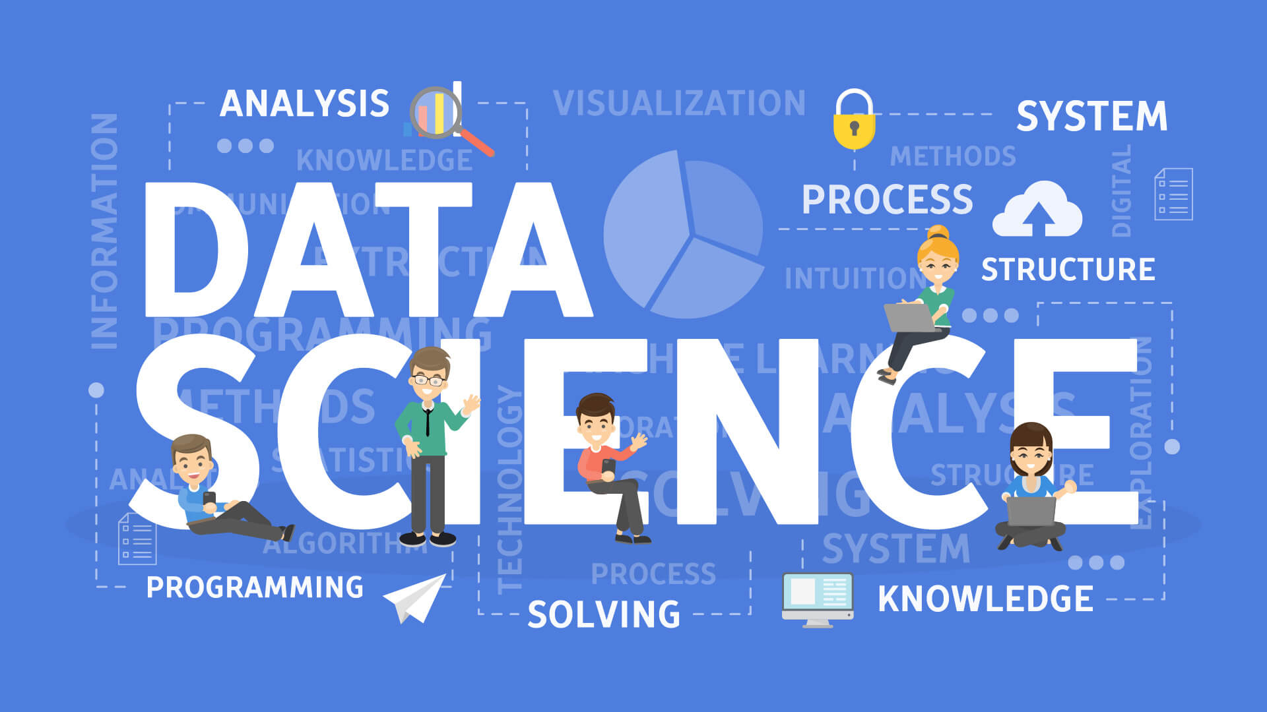
Data Science in Applied Sciences
What is Data Science?
An interdisciplinary field that uses scientific methods, algorithms, and systems to extract insights from structured and unstructured data.
Relevance in Applied Sciences:
Enhances decision-making and problem-solving in real-world applications.
Supports innovation and research across various domains (e.g., healthcare, environmental science, engineering).
Source :
https://www.decube.io/post/data-science-concept
Notes:
What is Data Science?
Data science is an interdisciplinary field that combines techniques from statistics, computer science, mathematics, and domain-specific knowledge to extract insights and knowledge from both structured and unstructured data. It encompasses a range of processes and methodologies, including data collection, cleaning, analysis, visualization, and interpretation. The ultimate goal of data science is to derive meaningful insights from data that can inform decisions, drive innovations, and enhance understanding in various contexts.
Key components of data science include:
Data Collection: Gathering data from multiple sources, including databases, sensors, online platforms, and other repositories.
Data Cleaning and Preparation: Processing raw data to remove inconsistencies, handle missing values, and format it for analysis.
Data Analysis: Using statistical methods and algorithms to explore data, identify trends, and uncover relationships.
Machine Learning: Applying algorithms that enable computers to learn from data and make predictions or decisions based on that data.
Data Visualization: Creating graphical representations of data to communicate findings effectively to stakeholders.
Relevance of Data Science in Applied Sciences
Data science plays a pivotal role in applied sciences by enhancing decision-making and problem-solving across various domains.
Supports innovation and research across various domains (e.g., healthcare, environmental science, engineering).

Slide 10
Applications of Data Science in Applied Sciences
Healthcare:
Predictive analytics for patient outcomes and treatment efficacy.
Analyzing patient data for personalized medicine.
Environmental Science:
Modeling climate change impacts using data-driven simulations.
Monitoring biodiversity and ecosystems through remote sensing.
Engineering:
Optimizing manufacturing processes with data analysis.
Predictive maintenance of machinery using IoT data.
Agriculture:
Precision farming techniques for crop yield optimization.
Analyzing soil and weather data for informed decision-making.
Notes:
Applications of Data Science
Data science is making significant strides across various fields, providing tools and techniques that drive innovation and improve outcomes. Below are key applications of data science in healthcare, environmental science, engineering, and agriculture.
1. Healthcare
Predictive Analytics for Patient Outcomes and Treatment Efficacy:
Data science algorithms analyze historical patient data, including demographics, medical history, and treatment responses, to predict future health outcomes. This can help healthcare providers identify high-risk patients and tailor interventions accordingly.
For example, machine learning models can forecast the likelihood of readmission for patients with chronic conditions, allowing for more proactive management.
Analyzing Patient Data for Personalized Medicine:
By leveraging genomic data, lifestyle factors, and previous treatment outcomes, data science enables personalized treatment plans. This approach can enhance the effectiveness of therapies and minimize side effects.
Techniques such as clustering and classification can identify patient subgroups that respond similarly to specific treatments, facilitating targeted therapies.
2. Environmental Science
Modeling Climate Change Impacts Using Data-Driven Simulations:
Data science models simulate various climate scenarios by analyzing historical weather data, greenhouse gas emissions, and environmental changes. These simulations help predict potential future impacts on ecosystems and human societies.
For instance, researchers can forecast how rising temperatures and changing precipitation patterns will affect agriculture, water resources, and biodiversity.
Monitoring Biodiversity and Ecosystems Through Remote Sensing:
Remote sensing technologies collect data from satellites and drones, which data scientists analyze to monitor habitat changes, species distributions, and ecosystem health.
Techniques such as image recognition and classification can be applied to satellite imagery to assess deforestation rates or identify critical habitats.
3. Engineering
Optimizing Manufacturing Processes with Data Analysis:
Data science helps identify inefficiencies in manufacturing processes by analyzing production data, workflow patterns, and machine performance. This can lead to improved efficiency, reduced waste, and lower costs.
For example, advanced analytics can optimize production schedules and inventory management, resulting in better resource allocation.
Predictive Maintenance of Machinery Using IoT Data:
Data from Internet of Things (IoT) devices attached to machinery can be analyzed to predict when equipment is likely to fail or require maintenance. This proactive approach reduces downtime and maintenance costs.
Techniques such as time series analysis and anomaly detection are commonly used to monitor equipment health and performance trends.
4. Agriculture
Precision Farming Techniques for Crop Yield Optimization:
Data science applications in precision agriculture involve analyzing data from sensors, drones, and satellites to optimize crop management practices. This can lead to increased yields and reduced resource consumption.
By assessing soil health, moisture levels, and crop growth stages, farmers can make informed decisions about irrigation, fertilization, and pest management.
Analyzing Soil and Weather Data for Informed Decision-Making:
Data scientists analyze historical and real-time soil and weather data to provide farmers with actionable insights. This includes predicting planting times, irrigation needs, and potential pest infestations.
Machine learning models can analyze weather patterns to optimize planting schedules, maximizing productivity while minimizing risks associated with adverse weather conditions.

Slide 11
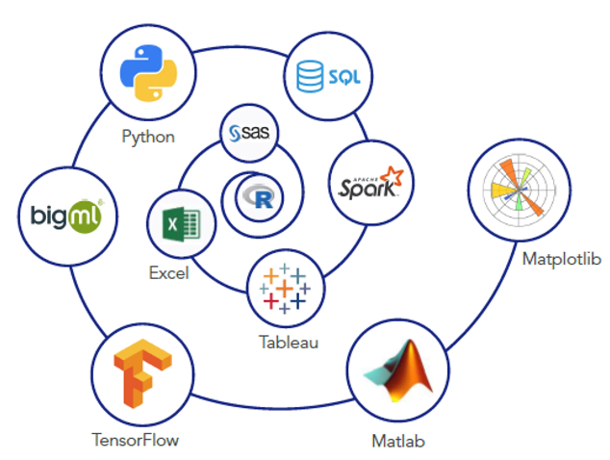
Tools and Techniques in Data Science
Common Tools:
Programming Languages: Python, R for data manipulation and analysis.
Data Visualization: Excel, Tableau, Power BI for presenting insights.
Machine Learning: TensorFlow, scikit-learn for predictive modeling.
Techniques:
Statistical Analysis: Identifying trends and patterns in data.
Machine Learning: Algorithms to automate data analysis and predictions.
Big Data Technologies: Hadoop and Spark for processing large datasets.
Source :
https://medium.com/javarevisited/10-essential-tools-data-scientists-should-learn-in-2022-acbae6558643
Notes:
Tools and Techniques for Data Science
Data science involves a diverse set of tools and techniques that enable practitioners to extract insights, analyze data, and develop predictive models. Here’s an overview of common tools and essential techniques used in the field.
Common Tools
Programming Languages
Python:
Widely used for data manipulation, analysis, and machine learning due to its simplicity and extensive libraries (e.g., Pandas, NumPy, Matplotlib, Seaborn).
Popular for tasks such as data cleaning, exploratory data analysis, and building machine learning models.
R:
A language specifically designed for statistical analysis and data visualization, favored among statisticians and data analysts.
Offers powerful packages like ggplot2 for visualization, dplyr for data manipulation, and caret for machine learning.
Data Visualization Tools
Tableau:
A leading data visualization tool that allows users to create interactive and shareable dashboards. It connects to various data sources and provides a user-friendly interface for visual analysis.
Power BI:
Developed by Microsoft, Power BI enables users to visualize data and share insights across organizations. It integrates well with other Microsoft products and offers a robust set of features for business analytics.
Machine Learning Libraries
TensorFlow:
An open-source library developed by Google for building and deploying machine learning models, particularly deep learning applications. It supports a wide range of neural network architectures and is highly scalable.
scikit-learn:
A versatile library for machine learning in Python that provides simple and efficient tools for data mining and data analysis. It includes various algorithms for classification, regression, clustering, and dimensionality reduction.
Techniques
Statistical Analysis
Descriptive Statistics: Summarizes data characteristics through measures such as mean, median, mode, variance, and standard deviation.
Inferential Statistics: Involves making predictions or inferences about a population based on a sample. Techniques include hypothesis testing, confidence intervals, and regression analysis.
Trend Analysis: Identifies patterns over time in datasets, often using time series analysis to forecast future values based on historical data.
Machine Learning
Supervised Learning: Involves training a model on labeled data to make predictions or classifications. Common algorithms include linear regression, decision trees, and support vector machines.
Unsupervised Learning: Involves finding hidden patterns or intrinsic structures in unlabeled data. Techniques include clustering (e.g., k-means, hierarchical clustering) and dimensionality reduction (e.g., PCA).
Reinforcement Learning: A type of machine learning where agents learn to make decisions by taking actions in an environment to maximize cumulative rewards.

Slide 12
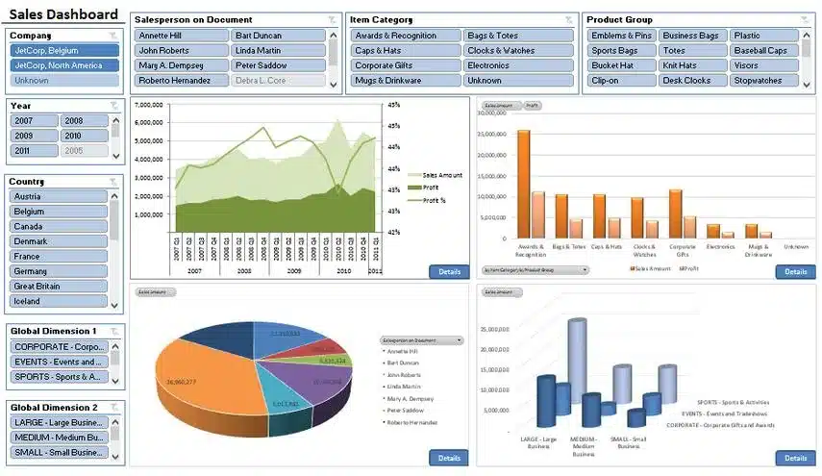
Introduction to Data Visualization using Excel
What is Data Visualization?
The graphical representation of information and data.
Helps in understanding trends, patterns, and outliers.
Importance in Excel:
Makes data analysis more accessible and intuitive.
Enhances presentations and reports.
Source :
https://zebrabi.com/best-practices-for-using-excel-for-data-visualization/
Notes:
What is Data Visualization?
Data visualization is the graphical representation of information and data. By utilizing visual elements like charts, graphs, and maps, data visualization tools provide an accessible way to see and understand trends, patterns, and outliers in data. The key benefits of data visualization include:
Simplification of Complex Data: Visualizations help break down large datasets into digestible pieces, allowing users to grasp essential insights quickly.
Identification of Trends and Patterns: Graphical representations make it easier to spot trends over time or highlight relationships between variables.
Highlighting Outliers: Visualizations can help identify anomalies or outliers in data that may require further investigation.
Importance of Data Visualization in Excel
Excel is one of the most widely used tools for data visualization, primarily due to its accessibility and powerful features. Here are some reasons why data visualization in Excel is crucial:
Accessibility and Familiarity:
Excel is user-friendly and widely used across industries, making it a go-to tool for many professionals. Most users are already familiar with its basic functions, allowing for a smoother learning curve when it comes to creating visualizations.
Diverse Visualization Options:
Excel provides a variety of chart types, including bar charts, line graphs, pie charts, scatter plots, and more. Users can choose the best type of visualization based on their data and the message they want to convey.
Data Analysis Made Intuitive:
By transforming data into visual formats, Excel enables users to analyze data more intuitively. Visuals can highlight relationships between data points, making it easier to draw conclusions without getting lost in raw numbers.
Enhances Presentations and Reports:
Well-designed visualizations can significantly improve the quality of presentations and reports. Visuals can communicate information more effectively than text alone, capturing the audience's attention and making complex data more understandable.
Interactive Features:
Excel offers interactive features such as slicers and pivot charts that allow users to manipulate data visualizations in real time. This interactivity helps users explore data from different angles and gain deeper insights.
Integration with Data Analysis Tools:
Excel integrates seamlessly with various data analysis tools and functions. Users can leverage Excel’s built-in formulas and functions to analyze data and then visualize the results directly, streamlining the workflow.
Customization and Flexibility:
Users can customize charts and graphs extensively in Excel, from colors and labels to layout and styles, ensuring that the visualizations meet their specific needs and preferences.

Slide 13
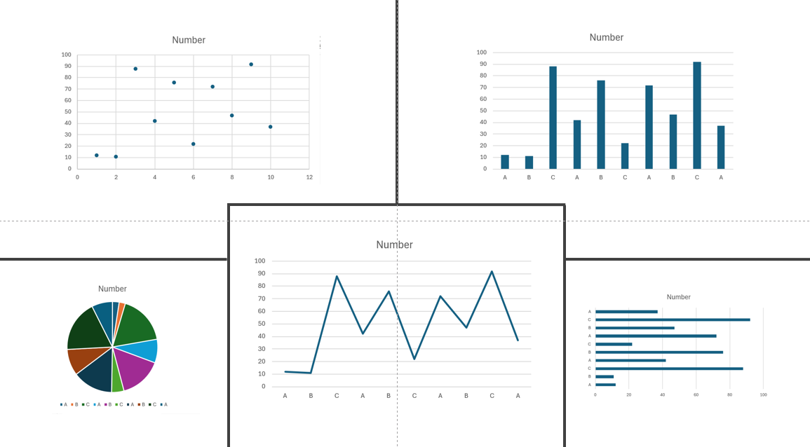
Types of Charts in Excel
Common Chart Types:
Column Chart: Compares values across categories.
Line Chart: Shows trends over time.
Pie Chart: Displays percentage share of parts to a whole.
Bar Chart: Similar to column charts but horizontal.
Scatter Plot: Shows relationships between two variables.
Choosing the Right Chart:
Consider data type and audience.
Notes:
Types of Charts in Excel
Excel provides a wide range of chart types, each designed to represent data visually in a way that highlights specific relationships or insights. Here’s a detailed look at some common chart types and tips for choosing the right one for your data.
Common Chart Types
Column Chart
This chart type uses vertical bars to represent data. Each bar's height corresponds to its value, making it easy to compare different categories.
Ideal for comparing values across different categories, such as sales figures for various products or survey results across demographics.
Example: Comparing monthly sales across different regions.
Line Chart
A line chart connects individual data points with a continuous line, emphasizing trends over time.
Best for displaying data trends across periods, such as stock prices over months or temperature changes throughout a year.
Example: Visualizing the trend of website traffic over the last 12 months.
Pie Chart
This circular chart is divided into slices that represent the proportion of each category to the whole. The size of each slice is proportional to its percentage of the total.
Effective for showing percentage shares of a whole, such as market share among competitors or budget allocation.
Example: Displaying the composition of a company’s revenue sources.
Bar Chart
Similar to column charts, but uses horizontal bars instead of vertical ones. This format can make it easier to read category labels, especially with long names.
Useful for comparing values across categories, especially when category names are lengthy.
Example: Comparing the number of users across different social media platforms.
Scatter Plot
A scatter plot uses dots to represent values for two different variables. The position of each dot indicates the relationship between the variables.
Best for showing correlations or relationships, such as the relationship between advertising spend and sales revenue.
Example: Analyzing the correlation between hours studied and exam scores.
Choosing the Right Chart
Selecting the appropriate chart type is crucial for effectively communicating your data.
Here are some considerations to guide your decision:
Consider the Data Type:
Categorical Data: Use column or bar charts to compare categories.
Continuous Data: Line charts are ideal for showing trends in continuous data over time.
Proportional Data: Pie charts are suitable for illustrating parts of a whole, while bar charts can show proportions if there are many categories.
Understand the Audience:
Complexity: For a general audience, simpler charts (like column or pie charts) may be more effective. For a more technical audience, scatter plots or more complex visualizations can convey detailed relationships.
Context: Consider what insights the audience is seeking. Choose a chart type that will highlight those insights clearly.
Keep Clarity and Simplicity in Mind:
Avoid clutter. Too many data points or excessive detail can overwhelm viewers. Choose a chart type that presents the data clearly without unnecessary complexity.
Use labels and legends appropriately. Ensure that viewers can easily understand what each part of the chart represents.
Test Different Options:
Sometimes, creating multiple chart types for the same dataset can help you find the most effective way to communicate your message. Excel allows you to easily switch between different chart types, so experiment to see what works best.

Slide 14
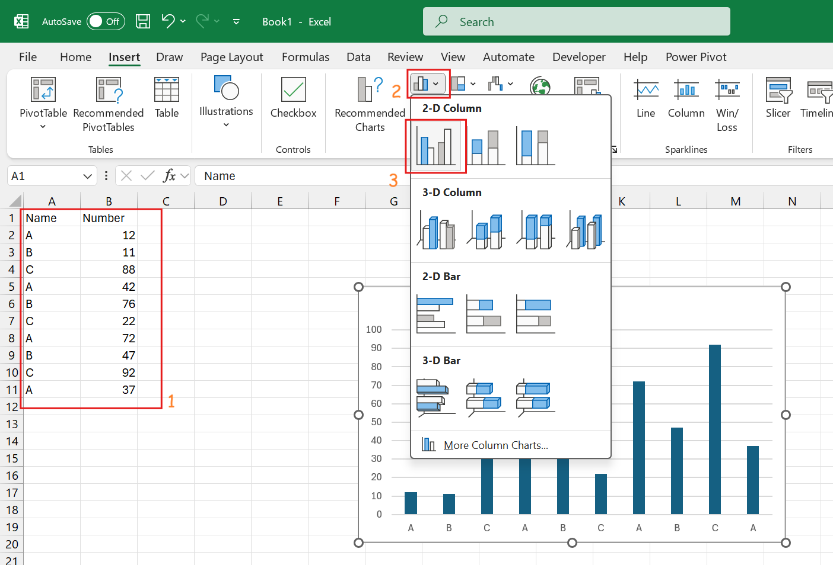
Creating a Simple Chart
Step-by-Step Guide:
Select Data: Highlight the data range for the chart.
Insert Chart: Go to the Insert tab > Choose Chart type.
Customize Chart: Use Chart Tools to format title, legend, and axes.
Final Touches: Add data labels and adjust colors as needed.
Notes:
Step-by-Step Guide:
Select Data: Highlight the data range for the chart.
Insert Chart: Go to the Insert tab > Choose Chart type.
Customize Chart: Use Chart Tools to format title, legend, and axes.
Final Touches: Add data labels and adjust colors as needed.

Slide 15
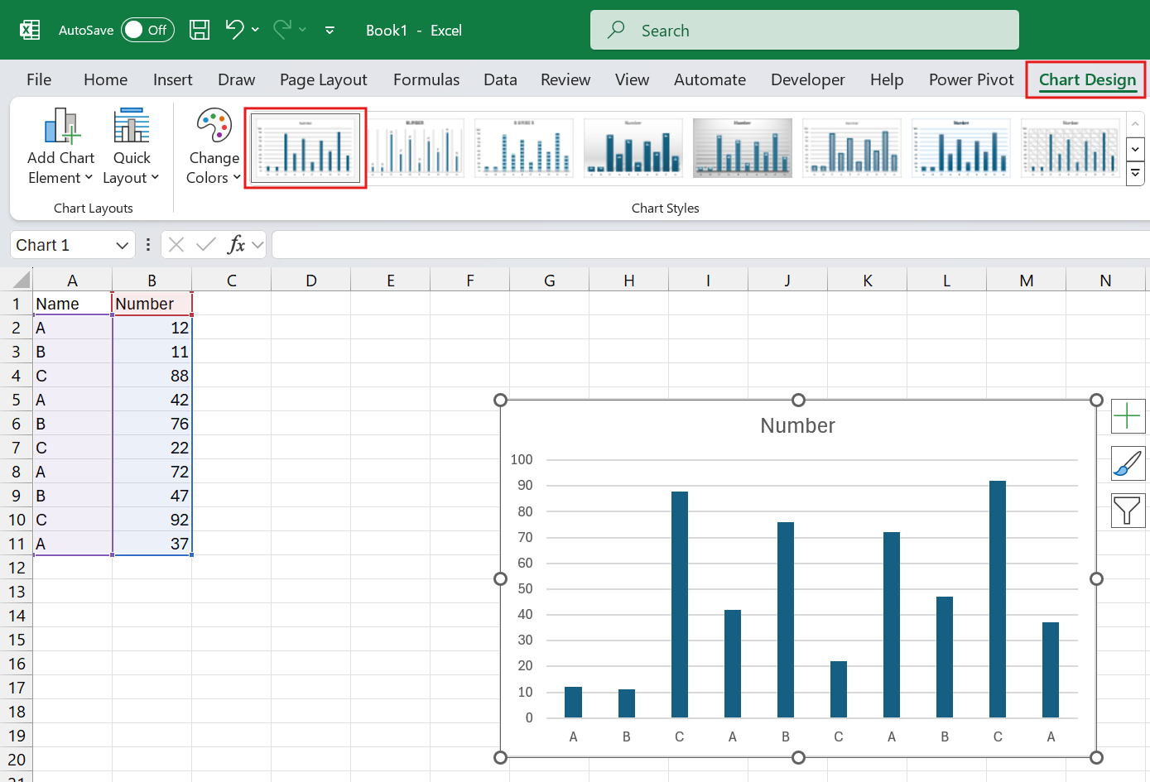
Customizing Your Charts
Using Chart Tools
Design Tab: Change chart styles, colors, and layout.
Format Tab: Modify individual chart elements (e.g., fonts, colors).
Adding Elements: Titles, axis labels, data labels, gridlines.
Using Templates: Save custom chart formats for future use.
Notes:
Using Chart Tools
Design Tab: Change chart styles, colors, and layout.
Format Tab: Modify individual chart elements (e.g., fonts, colors).
Adding Elements: Titles, axis labels, data labels, gridlines.
Using Templates: Save custom chart formats for future use.

Slide 16
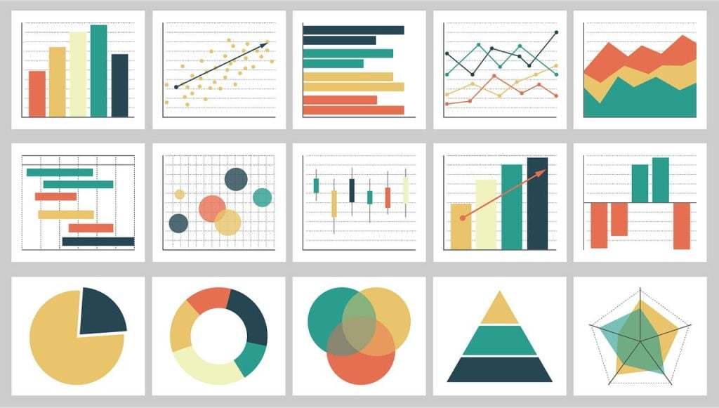
Best Practices for Data Visualization
Keep It Simple:
Avoid clutter; focus on key data points.
Be Consistent:
Use a uniform color scheme and font style.
Make It Accessible:
Consider color blindness and readability.
Provide Context:
Include legends and titles to explain data.
Source :
https://thenewstack.io/7-best-practices-for-data-visualization/
Notes:
Best Practices for Data Visualization
Creating effective data visualizations requires attention to detail and an understanding of how viewers will interpret the information presented. Following best practices can significantly enhance the clarity and impact of your visualizations. Here are some key guidelines to consider:
1. Keep It Simple
Avoid Clutter: Limit the number of data points and visual elements to focus on the most important information. Too much detail can overwhelm viewers and obscure key messages.
Highlight Key Data Points: Use emphasis (such as bolding or color contrast) to draw attention to critical insights. Focus on the main takeaway rather than trying to show every detail.
Choose Clear Visuals: Select chart types that best represent your data without unnecessary embellishments. Simplicity helps your audience understand the message quickly.
2. Be Consistent
Uniform Color Scheme: Stick to a consistent color palette throughout your visualizations. This helps viewers quickly recognize related information and improves the overall aesthetic.
Consistent Font Style: Use the same font type and size for titles, labels, and legends across all charts. Consistency in typography enhances readability and professionalism.
Standardized Layouts: Keep the layout of your charts and graphs similar across different visualizations. This makes it easier for your audience to interpret data without having to adjust to new formats.
3. Make It Accessible
Consider Color Blindness: Approximately 1 in 12 men and 1 in 200 women have some form of color blindness. Use color combinations that are distinguishable for everyone. Tools like color blindness simulators can help ensure accessibility.
Ensure Readability: Choose font sizes that are easily legible from a distance, especially for presentations. Avoid overly decorative fonts that may distract from the data.
Alternative Text Descriptions: For digital formats, provide alternative text descriptions for charts and graphs to assist those using screen readers.
4. Provide Context
Include Titles and Labels: Every chart should have a clear title that summarizes what the data represents. Axis labels and data point labels should be informative to provide context at a glance.
Use Legends: If your visualization has multiple data series, include a legend to explain what each series represents. Make sure the legend is easily identifiable and does not clutter the visualization.
Add Annotations: If specific data points are particularly significant, consider adding annotations to highlight them. This can provide additional context and guide the viewer's attention.

Slide 17
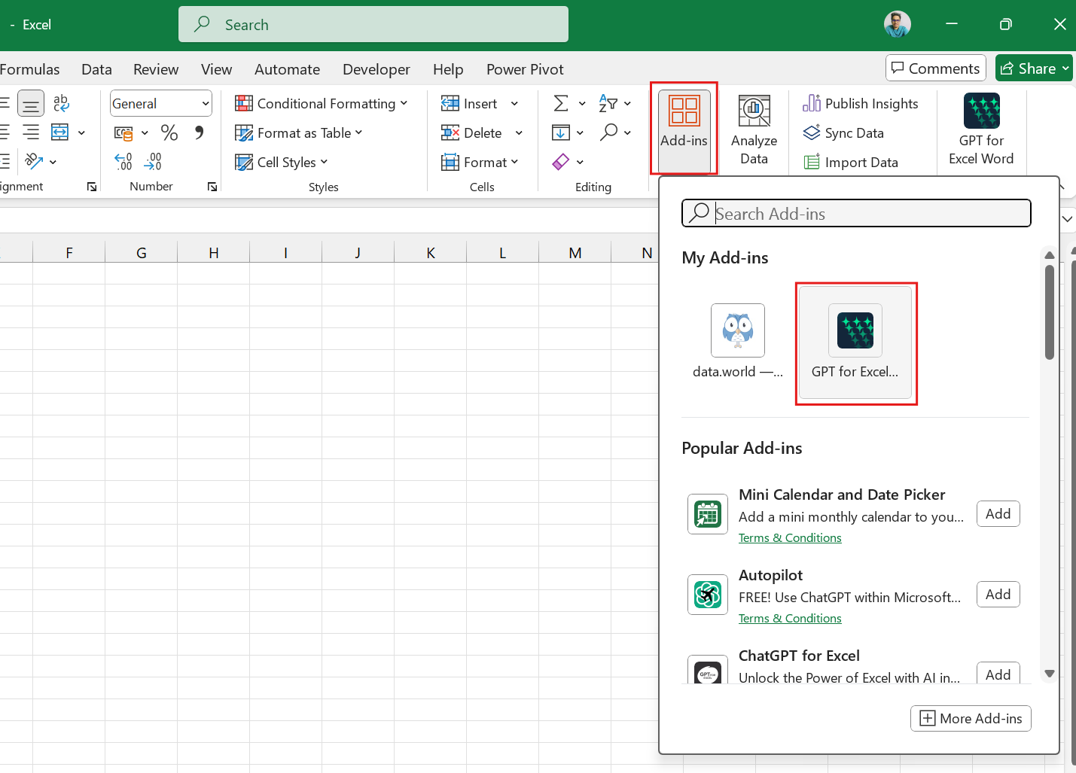
GPT for Excel
What is GPT?
A powerful AI language model developed by OpenAI that generates human-like text based on input.
Role of Excel:
A widely used spreadsheet application for data analysis, visualization, and management.
Combining GPT with Excel:
Enhances data analysis, automates repetitive tasks, and provides insights through natural language processing.
Notes:
What is GPT?
GPT (Generative Pre-trained Transformer) is a powerful AI language model developed by OpenAI. It is designed to understand and generate human-like text based on the input it receives. GPT can perform a variety of tasks, including:
Text Generation: Producing coherent and contextually relevant text based on prompts.
Question Answering: Responding to inquiries with informative answers derived from its training data.
Language Translation: Converting text from one language to another while maintaining meaning.
Summarization: Condensing lengthy texts into shorter summaries without losing key information.
The model's ability to understand context and generate nuanced responses makes it a versatile tool for many applications.
Role of Excel
Microsoft Excel is a widely used spreadsheet application that facilitates:
Data Analysis: Excel offers a robust suite of analytical tools, including functions, formulas, pivot tables, and data visualization capabilities.
Data Visualization: Users can create various charts and graphs to represent data visually, making it easier to identify trends and patterns.
Data Management: Excel provides features for organizing, filtering, and sorting data, allowing users to manage large datasets effectively.
Excel is widely utilized across industries for tasks ranging from simple calculations to complex financial modeling and statistical analysis.
Combining GPT with Excel
Enhances data analysis, automates repetitive tasks, and provides insights through natural language processing.

Slide 18

Lab Activity
Hands On
Lab 1
Visualizing Bar, Line, Scatter and Pie Chart using MS Excel

Slide 19
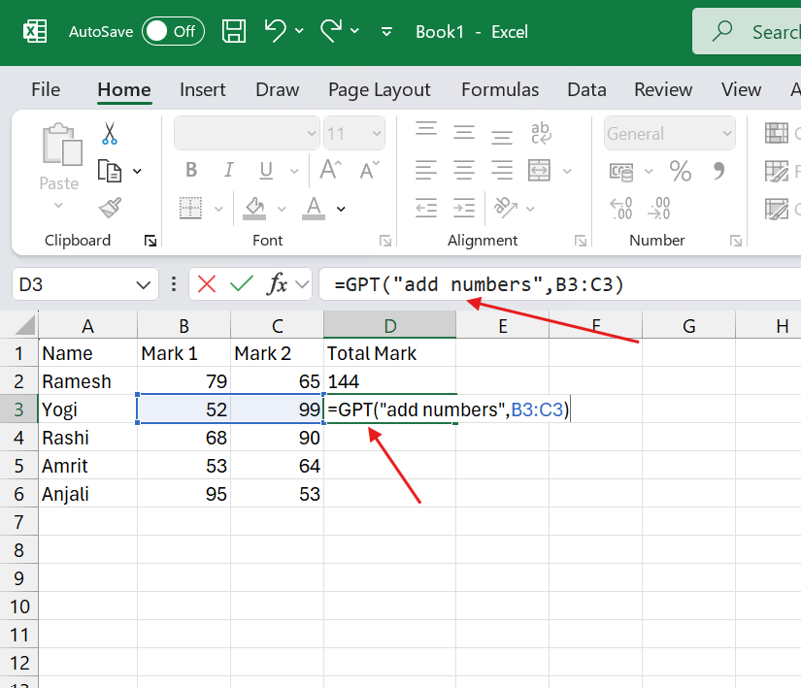
Features of GPT for Excel
Data Analysis and Insights:
Generate summaries and insights from large datasets quickly.
Answer complex questions about data trends and patterns.
Natural Language Queries:
Allow users to interact with Excel using plain language, making data manipulation more accessible.
Automated Reporting:
Create reports and dashboards automatically based on data inputs.
Notes:
Features of GPT for Excel
Integrating GPT with Excel enhances the functionality of the spreadsheet application, making data analysis and management more intuitive and efficient. Here are some of the key features that GPT brings to Excel:
1. Data Analysis and Insights
Generate Summaries and Insights from Large Datasets Quickly:
GPT can process and summarize extensive datasets, providing concise insights that help users grasp key information at a glance. For example, it can highlight trends, averages, or outliers without the user having to sift through all the data manually.
Answer Complex Questions About Data Trends and Patterns:
Users can pose complex questions about their data (e.g., "What factors contributed to the sales increase last quarter?"). GPT can analyze the data and generate responses that clarify trends and relationships, enabling more informed decision-making.
2. Natural Language Queries
Allow Users to Interact with Excel Using Plain Language:
GPT enables users to communicate with Excel using everyday language. Instead of needing to know specific formulas or commands, users can ask questions or make requests in plain English (e.g., "Show me the total expenses for this month"), and GPT will generate the corresponding actions or formulas automatically.
Simplify Data Manipulation and Analysis:
This feature reduces the learning curve for new Excel users and makes data manipulation more accessible to those without extensive technical knowledge. Users can focus on what they want to achieve rather than how to achieve it with complex formulas.
3. Automated Reporting
Create Reports and Dashboards Automatically Based on Data Inputs:
GPT can automate the generation of reports and dashboards by analyzing the data and creating visualizations or textual summaries that reflect the data's current state. This saves users time and effort, allowing them to focus on interpreting the results instead of compiling them.
Tailored Reporting Based on User Preferences:
Users can set preferences for how they want reports formatted or the types of insights they are interested in, and GPT can adjust the reports accordingly. This personalization enhances the relevance of the information provided.

Slide 20
Use Cases of GPT in Excel
Financial Analysis:
Generate financial forecasts and analyze budget data using natural language.
Marketing Analytics:
Summarize customer feedback and sentiment analysis from survey data.
Data Cleaning:
Suggest cleaning methods and highlight inconsistencies in datasets.
Personalized Dashboards:
Create tailored dashboards based on user-defined criteria and goals.
Notes:
Use Cases of GPT in Excel
The integration of GPT with Excel offers various innovative use cases across different domains, enhancing data analysis, reporting, and decision-making. Here are some key use cases:
1. Financial Analysis
Generate Financial Forecasts:
Users can input historical financial data and ask GPT to generate forecasts for future revenue, expenses, or cash flows. For example, a user might type, "What are the projected sales for the next quarter based on the last three years of data?" GPT will analyze the provided data and produce a forecast.
Analyze Budget Data Using Natural Language:
GPT can help users understand budget performance by answering queries like, "How does this quarter's spending compare to the budget?" or "What areas exceeded budget expectations?" This simplifies the financial review process, enabling quick insights without complex formula creation.
2. Marketing Analytics
Summarize Customer Feedback:
By analyzing survey responses or customer reviews, GPT can summarize sentiment and key themes. For instance, users can ask, "What are the main points of feedback from our last marketing campaign?" GPT can quickly extract and present the most relevant insights, aiding in decision-making.
Sentiment Analysis from Survey Data:
GPT can process qualitative data to provide sentiment scores or categorize feedback into positive, negative, or neutral sentiments. This allows marketers to gauge overall customer satisfaction and identify areas for improvement.
3. Data Cleaning
Suggest Cleaning Methods:
When users upload messy or inconsistent datasets, GPT can propose specific cleaning methods. For example, it might suggest removing duplicates, filling in missing values, or standardizing formats. Users can receive tailored recommendations based on the nature of their data.
Highlight Inconsistencies in Datasets:
GPT can analyze the dataset and identify anomalies, such as outliers or inconsistencies in data entry. For instance, if a user has entered inconsistent date formats, GPT could flag these issues, allowing for quicker resolution.
4. Personalized Dashboards
Create Tailored Dashboards:
Users can describe their specific reporting needs and objectives (e.g., "Create a sales dashboard that tracks monthly performance against targets"). GPT can generate customized dashboards that include relevant metrics, charts, and visualizations tailored to the user's preferences.
Dynamic Updates Based on User-Defined Criteria:
GPT can automate the updating of dashboards based on defined criteria, such as changes in key performance indicators (KPIs) or triggers based on specific thresholds. This ensures users have the most current and relevant information available at their fingertips.

Slide 21
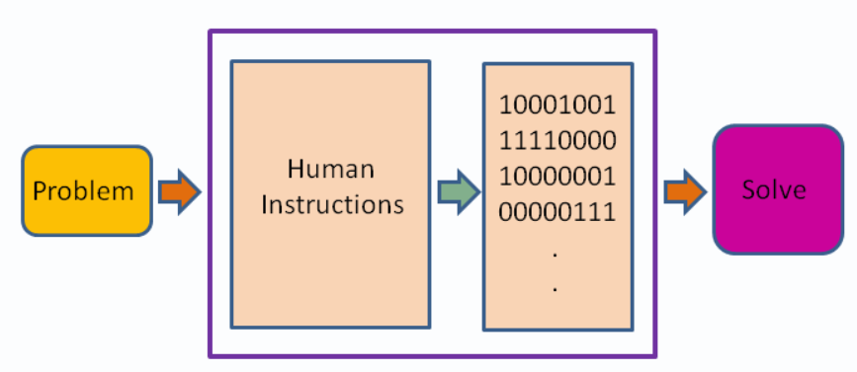
What is programming language ?
A programming language is a formal set of instructions that can be used to produce various kinds of output, such as software programs, websites, and mobile apps. It provides the means for a programmer to communicate with a computer, instructing it on how to perform specific tasks.
Source :
https://en.wikiversity.org/wiki/Introduction_to_Programming/About_Programming
Notes:
What is programing language ?
Starts with Example to understand the what is programming language
Scenario : Come up with a sequence of instructions to tell someone how to make a peanut butter sandwich. Don't leave any steps out, or put them in the wrong order.
Explanation:
Was that easy? Did you remember all the steps? Maybe you forgot to tell me to use a knife to spread the peanut butter. Now I've got peanut butter all over my hands! Of course, you say, a person wouldn't be that dumb. But a computer is that dumb. A computer will only do what you tell it to do. This might make programming frustrating at first, but it's relieving in a way: if you do everything right, you know exactly what the computer is going to do, because you told it.
Of course, computers don't understand recipes written on paper. Computers are machines, and at the most basic level, they are a collection of switches—where 1 represents "on" and 0 represents "off". Everything that a computer does is implemented in this most basic of all numbering systems—binary. If you really wanted to tell a computer what to do directly, you'd have to talk to it in binary, giving it coded sequences of 1s and 0s that tell it which instructions to execute.

Slide 22
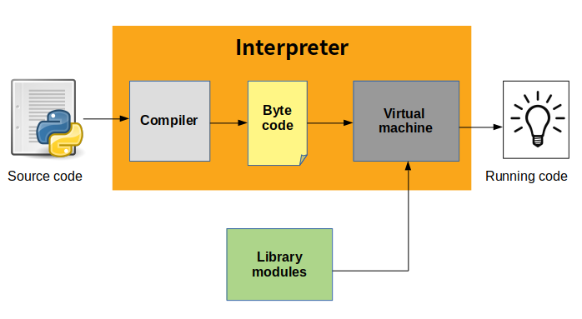
What is Python ?
Python is a general-purpose, dynamically typed, high-level, compiled and interpreted, garbage-collected, and purely object-oriented programming language that supports procedural, object-oriented, and functional programming.
Source :
https://medium.com/@potnuruurmila3/simple-discussion-about-python-and-its-workflow-e182d78fae6a
Notes:
What is Python ?
Lets understand the what is python, In the dynamic realm of programming languages, Python stands as a towering figure, weaving a rich tapestry of simplicity, versatility, and innovation. Conceived in the late 1980s by the ingenious Guido van Rossum, Python has evolved into a programming language that transcends boundaries and resonates across diverse sectors of the technological landscape.
Python is an object-oriented, high-level, interpreted programming language with dynamic semantics.
It is suitable for Rapid Application Development as well as for usage as a scripting or glue language to link already existing components because of its high-level built-in data structures, dynamic typing, and dynamic binding.
Python's basic, English-like syntax places a strong focus on readability and has an easy learning curve. This also lowers the cost of program maintenance for users.
Python's support for modules and packages promotes the modularity and reuse of code in programs.
The comprehensive standard library and the Python interpreter are freely distributable and are offered in source or binary form for all commonly used platforms.

Slide 23
Why Python ?
Easy to learn and beginner-friendly
Python's simple syntax and readability make it accessible for beginners, supporting a wide range of applications, from simple scripts to complex projects.
Versatile with Extensive Libraries
Python is used in diverse fields like web development, data science, and automation, with powerful libraries such as NumPy, Pandas, and TensorFlow.
Interpreted and Interactive
Python runs code at runtime without needing compilation, and its interactive mode allows for real-time testing and rapid prototyping.
Strong Community and Cross-Platform Support
Python has a vast community, extensive support, and works seamlessly on various platforms like Windows, macOS, and Linux.
Notes:
Why to learn Python?
Choosing Python as a programming language comes with numerous advantages, making it a popular choice among developers, data scientists, and educators.
Overall, Python's ease of use, versatility, extensive libraries, strong community support, and broad applicability across different domains make it an attractive choice for programmers at all levels. Whether you're a beginner looking to start your programming journey or an experienced developer seeking to expand your skill set, Python offers the tools and resources necessary to succeed.
Interpreted
Python code is processed at runtime by the interpreter, eliminating the need for a separate compilation step before execution. This feature is like languages such as Perl and PHP.
Interactive
Python allows for direct interaction with the interpreter, which facilitates real-time code writing and testing. This interactive nature is valuable for rapid prototyping and experimentation.
Beginner-Friendly
Python is renowned for being an excellent choice for beginners. It's simple syntax and readability support the development of various applications, from basic text processing scripts to complex web browsers and games.

Slide 24
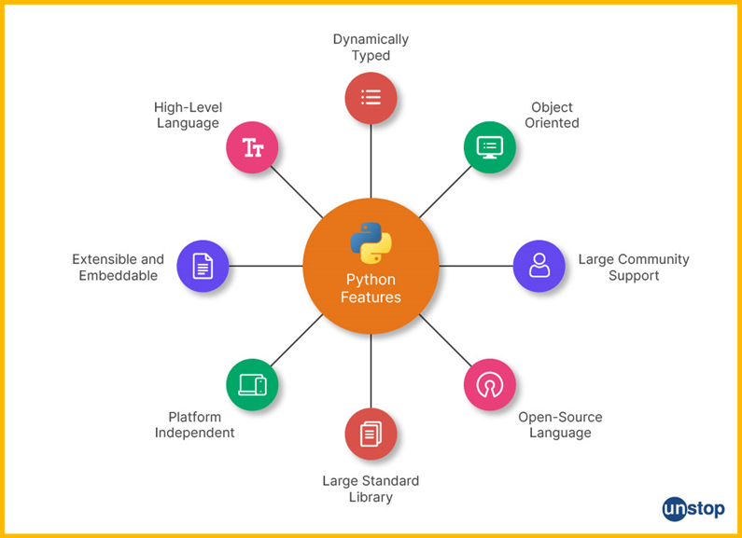
Python Features
Source :
https://unstop.com/blog/what-is-python
Notes:
Python Features
Now, we're going to explore some of the most important and powerful features of the Python programming language. Whether you're new to Python or looking to deepen your understanding, this presentation will provide valuable insights into what makes Python such a popular and versatile language
Portable Language
Python is a cross-platform language, meaning it can run on Linux, macOS, and Windows. For example, Python code written for Windows can also be executed on Linux or macOS without modification.
Comprehensive Standard Library
Python offers a wide range of modules, such as operators and mathematical functions, along with libraries like NumPy, Pandas, and TensorFlow. These resources save developers time by avoiding the need to write code from scratch. Additionally, the Python Package Index (PyPI) provides even more functionality and packages.
High-Level Language
Python is a high-level, general-purpose language, making it easier to read and understand compared to machine languages like C or C++. This makes Python accessible, even for those without a technical background.
Easy to Learn and Use
Python is simple to learn and code in, allowing beginners to pick it up quickly. For example, a basic Python program to add two numbers takes only three lines of code.
Dynamic Language
Python does not require variable type declarations. For example, instead of declaring an integer variable in C like this:
int a = 7, but in Python, you simply write: a = 7.
However, developers need to be cautious about potential runtime errors due to this flexibility.
Extensible Language
Python code can integrate with C or C++ code, enhancing its capabilities. This is made possible by Python’s ability to convert programs into bytecode.
Interpreted Language
Python is interpreted, meaning its code is executed line by line and converted into bytecode. This eliminates the need for compilation, making debugging easier if issues arise.
Object-Oriented Programming Language
Python supports various programming paradigms, including procedural, functional, and object-oriented programming. Key object-oriented principles such as abstraction, encapsulation, inheritance, and polymorphism are all supported.
Free and Open Source
Python is open-source and free to download from its official website, making it accessible to everyone.
Graphical User Interface (GUI) Support
Python provides numerous GUI frameworks, enabling developers to create software with graphical interfaces. This makes Python a powerful tool for software and web development, supporting platform-specific technologies.

Slide 25
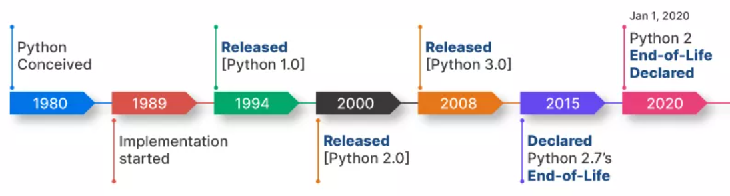
Python History
Source :
https://unstop.com/blog/what-is-python
Notes:
Python History
The history of the Python programming language is marked by its evolution from a pet project to a powerhouse in the world of software development. It is not just a chronicle of versions and releases. It is a testament to the collaborative spirit of its community, the adaptability of its design, and its enduring commitment to simplicity and readability.
Lets discuss year wise:
Genesis (Late 1980s): Python's story begins in the late 1980s when Guido van Rossum, a Dutch programmer, started working on a hobby project during the Christmas holidays. His goal was to create a language that emphasized code readability and allowed for the creation of both small and large-scale software projects.
Python 0.9.0 (February 1991): The first official release of Python, version 0.9.0, came in February 1991. This release already included features that have remained integral to Python, such as exception handling, functions, and modules.
Python 1.0 (January 1994): The beginning of 1994 brought the release of Python 1.0 and marked the language's maturation. The January issue included features like lambda, map, filter, and reduce, reflecting a growing emphasis on functional programming constructs.
Python 2.0 (October 2000): The next milestone for this language was the release of Python 2.0 in October 2000. This version introduced list comprehensions, garbage collection, and Unicode support. And also solidified Python's position as a powerful and efficient language for various applications.
The PEP Process (2000 Onwards): Guido van Rossum introduced the Python Enhancement Proposal (PEP) process in 2000 to manage and propose new features for the language. This transparent and community-driven approach allowed developers to actively participate in shaping the language's future.
Python 3.0 (December 2008): Also known as Python 3000 or Py3k for short, the release of Python 3.0 represents one of the most significant milestones in its history. It aimed to rectify design flaws and improve the language's consistency. While backward incompatible, Python 3 laid the foundation for a more robust and modern language.
Community Growth and Ecosystem (2010s): Throughout the 2010s, Python's community and ecosystem expanded rapidly. The growth was fueled by the rise of web development frameworks like Django and Flask, data science libraries such as NumPy and Pandas, and the language's suitability for machine learning and artificial intelligence.
Guido van Rossum's Retirement (July 2018): In July 2018, Guido van Rossum, the Benevolent Dictator For Life (BDFL) of Python, stepped down from his leadership role. This marked a shift in the governance model, with the Python Steering Council taking over the decision-making process.
Python 2 End of Life (January 2020): Python 2 reached the end of its life on January 1, 2020. With this, the Python community's focus shifted entirely to Python 3, encouraging users to migrate their codebases to the latest version.
Python 3.9 (October 2020): Python 3.9 continued the tradition of introducing new features and optimizations. It showcased Python's commitment to staying at the forefront of technology while maintaining stability and backward compatibility.
Continued Relevance and Future (2020s Onwards): Python's popularity continues to soar in the 2020s, with its applications expanding into areas such as data science, machine learning, and artificial intelligence. The language's readability, extensive library support, and vibrant community position it as a linchpin in contemporary software development.

Slide 26
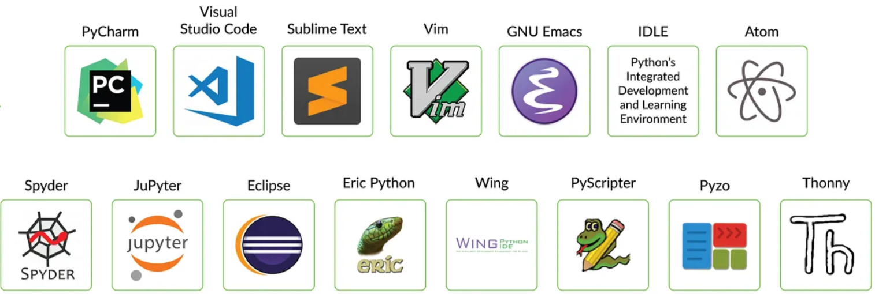
Python compatible IDE
Notes:
Python IDEs (Integrated Development Environments) and code editors offer a variety of features that make coding in Python more efficient and productive.
Key Features of Python IDEs
Integrated Development Environment:
IDEs combine a code editor, debugger, compiler, and other tools in one package.
Code Autocompletion & IntelliSense:
Suggests methods, functions, variables, and libraries as you type. This feature speeds up coding and reduces typos.
Integrated Debugging:
Python IDEs come with built-in debuggers to help identify and fix issues by stepping through the code, setting breakpoints, and inspecting variables.
Version Control Integration:
Many IDEs (e.g., PyCharm) integrate with Git and other version control systems, enabling easy commit, push, and pull operations within the IDE.
Syntax Highlighting:
Automatically highlights Python keywords, functions, classes, and variables in different colors, making the code easier to read and understand.
Project Management:
IDEs allow you to manage multiple files and projects, providing features like project structure, navigation tools, and dependency management (virtual environments).
Code Refactoring Tools:
Tools to rename variables, extract methods, and simplify code, which makes large projects easier to maintain and improve over time.
Unit Testing Support:
Integrated testing frameworks (e.g., pytest, unittest) allow you to run unit tests and view the results directly in the IDE.
Integrated Terminal:
Most Python IDEs offer an embedded terminal, allowing users to run scripts, manage environments, and execute shell commands without leaving the IDE.
Plugin Ecosystem:
IDEs like PyCharm and VS Code support plugins and extensions that enhance functionality (e.g., for Django, Flask, machine learning, or data science).
Database Management Tools:
Some IDEs come with tools to connect and manage databases (SQLite, MySQL, PostgreSQL), enabling query execution and schema visualization.
Cross-Platform Compatibility:
IDEs like PyCharm, Visual Studio Code, and Spyder work across different operating systems (Windows, macOS, and Linux).
Popular Python IDEs:
PyCharm (JetBrains)
Spyder (Scientific Python Development Environment)
Eclipse + PyDev (Eclipse IDE with Python plugin)
Thonny (Beginner-friendly Python IDE)
IDLE (Python’s built-in IDE)
Key Features of Python Code Editors
Lightweight:
Code editors are generally faster and use fewer resources compared to full IDEs. They load faster, making them ideal for smaller projects or quick edits.
Code Autocompletion:
Like IDEs, most modern code editors support autocompletion, although the level of sophistication may vary. They help you write code faster by suggesting methods, functions, or libraries.
Syntax Highlighting:
Code editors offer syntax highlighting for Python code, which helps improve readability by differentiating keywords, variables, and functions.
Customizable with Plugins:
Code editors like Visual Studio Code and Sublime Text are highly customizable with plugins. You can add extensions for linting, debugging, or other languages.
Git Integration:
While code editors aren’t full-featured like IDEs, many (e.g., VS Code, Sublime) offer Git integration for basic version control tasks like commits, pull requests, and branching.
Linter & Formatting Tools:
Popular editors support linting tools (e.g., flake8, pylint) and formatting tools like Black, ensuring that your code adheres to best practices.
Integrated Terminal:
Some code editors, like Visual Studio Code, come with an integrated terminal that allows users to run Python scripts and commands without switching windows.
Multi-language Support:
Unlike most IDEs that are language-specific, code editors like VS Code and Sublime Text support multiple languages (Python, JavaScript, HTML, etc.) in one environment.
File and Folder Management:
Code editors typically provide basic project or folder navigation, though not as extensive as full-fledged IDEs.
Search and Replace:
Efficient searching within files, folders, and across projects. This feature makes refactoring or navigating large codebases quicker.
Remote Development:
Some code editors, like VS Code, support remote development extensions, enabling coding on remote servers or containers.
Popular Python Code Editors:
Visual Studio Code (Microsoft)
Sublime Text
Atom (GitHub)
Vim/Neovim (for advanced users)
Notepad++ (Windows)

Slide 27
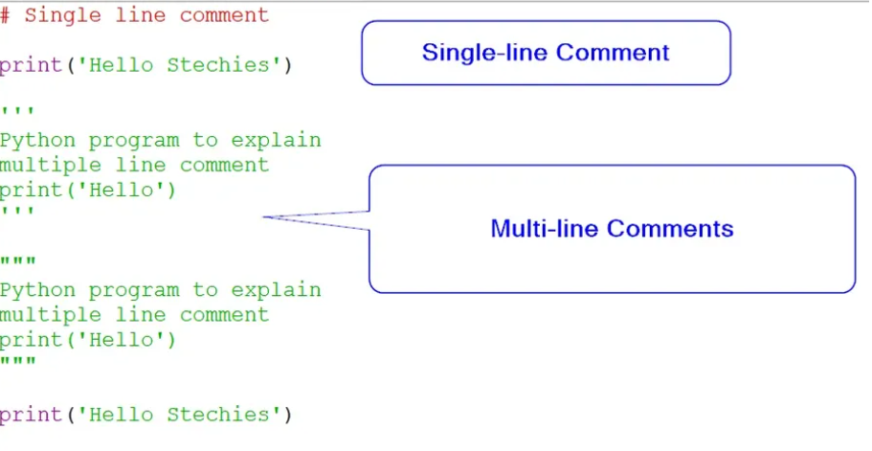
Comments in Python
Single-line Comments
# defining a single-line comment
print('Hello World!’)
Multi-line Comments
"""
This is a multi-line comment
written in
more than just one line
"""
'''
This is another multi-line comment
written in
more than just one line
'''
print("Hello, World!")
Notes:
Comments in Python
In programming, every line of a program described the sequence of steps required to achieve an output. This output may be based on some input provided by the user. Some lines of the program may be easy and self-explanatory. But, some lines can be a little complicated such as a for loop or a function call. Someone else reading the code may find it difficult to understand. That is where comments come in handy.
Comments are used for specifying what a particular line means. This makes it easy for you to understand it when you read it later. Moreover, others can also read the comments and make sense out of your code.
Types of comments
Single-line Comments
Multi-line Comments
Single-line Comments
In Python, single-line comments are used for commenting out single lines of code. These comments start with a # symbol. The symbol is then followed by the text explaining the line of code.
Multi-line Comments
If you want to write a comment that spans multiple lines, multiline comments can be used. These comments may be used to describe a particular code block. Multiline comments can be declared using two ways. You can specify these comments using ''' (Triple single quotes) or """ (Triple double quotes). The quotes are mentioned at the beginning and at the end of the comments.

Slide 28
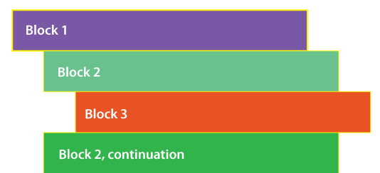
Lines and Indentation
Lines
Each line of code in Python represents a single statement or instruction.
Indentation
Indentation refers to the use of spaces and tabs at the beginning of statements, methods, and code blocks.
Proper indentation helps clearly identify the starting and ending points of conditional loops, functions, if-else statements, and other control structures.
Notes:
Lines and Indentation in Python
In programming, every line of a program described the sequence of steps required to achieve an output.
Each line typically represents a single statement, and indentation is used to define code blocks, particularly in control structures.
Indentation in Python refers to the use of spaces and tabs at the beginning of statements, methods, and code blocks. Proper indentation helps clearly identify the starting and ending points of conditional loops, functions, if-else statements, and other control structures.
Basic Indentation Rules in Python
Consistent Indentation: Proper indentation must be maintained for each block of code, ensuring clear beginnings and endings of loops, functions, and conditional statements.
Line Continuation: Programmers can split long lines of code by using a backslash (\) to indicate continuation onto the next line.
Indentation Errors: If proper indentation is not followed, Python will raise an IndentationError, which prevents the code from compiling successfully.
Challenges with Large Code: Maintaining consistent indentation can be challenging in large codebases with many lines, but it is essential for readability and organization.
Simplicity in Syntax: Indentation allows Python to avoid the use of brackets for code blocks, making the syntax simpler and cleaner compared to many other programming languages.
Efficiency: By reducing the need for brackets, indentation saves time, decreases the number of lines of code, and enhances execution speed.
Fixed Whitespace: The number of spaces used for indentation in a block of code is fixed. When using nested conditional statements, additional whitespace is required for each level of nesting, in accordance with the indentation rules.

Slide 29
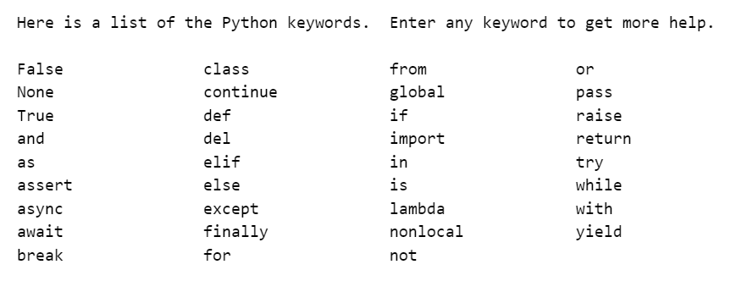
Python keywords and identifiers
Python Keywords
Keywords are reserved words that have specific meanings and purposes.
Notes:
Python keywords and identifiers
Python Keywords
Keywords in Python are reserved words that have specific meanings and purposes. These words cannot be used as identifiers (like variable names, function names, etc.) because they are part of the syntax. Python has a set of keywords that are predefined and case-sensitive.

Slide 30
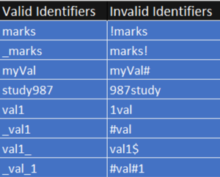
Python identifiers
An identifier is the name given to variables, functions, classes, or other objects.
Rules for Naming Python Identifiers
Python keywords cannot be used as identifiers.
Whitespace is not allowed in identifiers.
Identifiers may consist of uppercase letters (A-Z), lowercase letters (a-z), digits (0-9), or underscores (_).
It must begin with either an alphabetic character or an underscore (_).
Special characters, except for the underscore (_), are not permitted in identifiers.
Notes:
Python keywords and identifiers
An identifier is the name given to variables, functions, classes, or other objects.
Rules for Identifiers:
The Identifiers are case-sensitive. variable and Variable would be considered different identifiers.
Identifiers can contain letters (both uppercase and lowercase), digits, and underscores (_).
However, identifiers cannot start with a digit. For example, 1variable is invalid, but variable1 is valid.
Identifiers can’t include special characters like @, $, %, #, etc.
Python keywords or reserved words cannot be used as identifiers. For example, if, else, class, for, and True are reserved and cannot be used for naming.
Underscore Conventions
Single leading underscore (_var) used to indicate that a variable or method is intended for internal use. It’s a convention but does not prevent access.
Double leading underscore (__var) used to invoke name mangling, where the interpreter changes the name of the variable in a way to avoid conflicts in subclasses.
Double leading and trailing underscores (__init__) reserved for special use in the language, such as special methods (also known as "magic" or "dunder" methods).

Slide 31
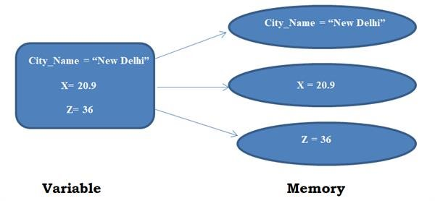
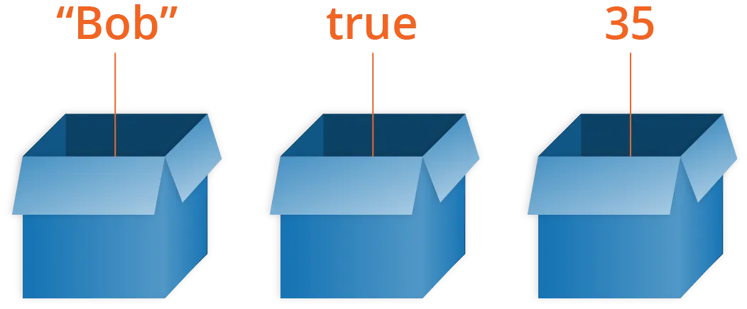
Variables in Python
Python variables are simply containers used to store data values.
A variable refers to a memory location where data is stored, and the name of the variable is known as an identifier.
Python is a dynamically typed language, meaning it can automatically infer the type of the variable based on the assigned value.
Source :
https://www.edureka.co/blog/variables-and-data-types-in-python/
Notes:
Variables in Python
In Python, variables serve as containers that store data values, functioning as a crucial part of the programming process. Each variable refers to a specific memory location where the data it holds is stored, and this memory location is accessed using a name known as an identifier. Identifiers are the names we assign to variables, and they help programmers reference the stored data later in the code.
Key Characteristics of Python Variables:
Memory Location Reference:
When you assign a value to a variable, Python links the variable's identifier to a memory location where the actual value is stored. This means that the variable doesn't hold the value directly, but rather points to it in memory. This allows the program to efficiently manage memory and retrieve or update the value as needed.
Dynamic Typing:
Python is a dynamically typed language, which means that the programmer does not need to explicitly declare the data type of a variable when assigning a value to it. Python automatically determines the data type based on the value assigned.
For example, if you assign an integer like x = 10, Python will automatically infer that x is of type int. Similarly, if you later assign a string value to x, like x = "Hello", Python will dynamically change the type of x to str (string). This flexibility simplifies coding and enhances readability, as there's no need for manual type declarations.

Slide 32
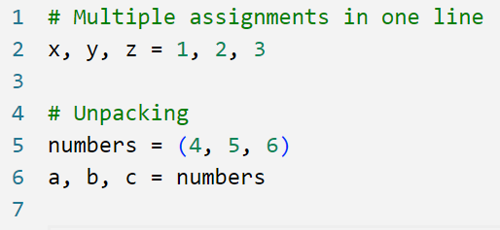
Variables in Python
Assign Value to Multiple Variables:
Python allows to assign values to multiple variables in one line.
You can also unpack a collection of values into individual variables.
Notes:
Variables in Python
Python provides the convenient ability to assign values to multiple variables in a single line. This can be done by separating each variable and value with a comma.
Example:
Assigning Values to Multiple Variables: Python allows you to assign values to multiple variables in one line. For example, x,y, z = 1, 2, 3 assigns 1 to a, 2 to b, and 3 to c.
Unpacking a Collection: You can also unpack a collection of values into individual variables. For instance, a, b, c = [4, 5, 6] assigns 4 to a, 5 to b, and 6 to c by unpacking the list [4, 5, 6].

Slide 33
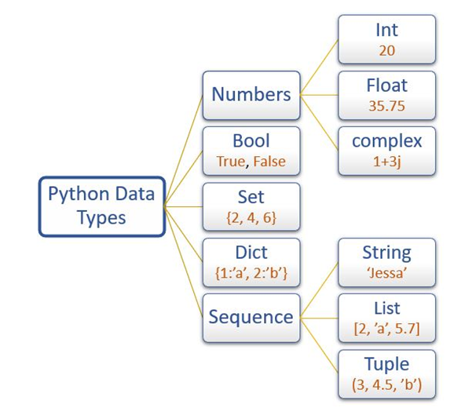
Data Types in Python
Python supports various data types to store different kinds of data.
Source :
https://www.emexotechnologies.com/python-data-types/
Notes:
Data Types in Python
In Python, every value has a datatype, and variables are used to hold these values.
One of the powerful features of Python is that it is a dynamically typed language. This means we don't need to specify the type of a variable when we declare it.
The Python interpreter automatically assigns the appropriate type based on the value assigned.
For example:
a = 5
Here, we haven't specified the type of the variable a. We just assigned the value 5 to it. The Python interpreter automatically interprets a as an integer.
Checking Variable Types
We can verify the type of a variable using the type() function.
This function returns the type of the variable passed to it.
Example:
print(type(a))
Output
<class 'int’>
confirming that a is an integer.
Variety of Values
A variable in Python can hold different types of values.
For example, an ID should be stored as an integer, while a person's name should be stored as a string.
Python provides specific storage methods for each standard data type, making it easy to manage and manipulate data.
Python-Defined Data Types
Numbers: This includes integers, floating-point numbers, and complex numbers.
Dictionary: This is an unordered collection of key-value pairs
Boolean: This includes the Boolean values True and False.
Set: This is an unordered collection of unique items.
Sequence Type: This includes strings, lists, and tuples.

Slide 34
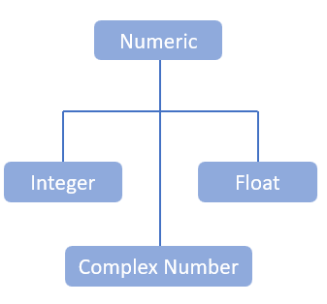
Numeric Data Type
Represents data with a numeric value.
Includes integers, floating numbers, and complex numbers.
Integers (int class):
Positive or negative whole numbers (no fractions or decimals).
No limit to the length of an integer value in Python.
Float (float class):
Real numbers with floating-point representation.
Specified by a decimal point.
Can include scientific notation (e.g., e or E followed by an integer).
Complex Numbers (complex class):
Specified as (real part) + (imaginary part)j.
Example: 2+3j.
Notes:
Numeric Data type in Python
These are essential for representing data with numeric values, and they include integers, floating-point numbers, and complex numbers.
These types are defined by Python's built-in classes: int, float, and complex.
Integers (int class)
Integers are positive or negative whole numbers without fractions or decimals.
One of the remarkable features in Python is that there's no limit to the length of an integer value. For example, you can have:
a = 12345678901234567890
print(a)
Float (float class)
Floats are real numbers with floating-point representation, specified by a decimal point.
You can also use scientific notation to represent these numbers, using e or E followed by an integer. For example:
b = 3.14
c = 2e10
print(b, c)
Complex Numbers (complex class)
Complex numbers in Python are specified as (real part) + (imaginary part)j. For example:
d = 2 + 3j
print(d)
Here, 2 is the real part and 3j is the imaginary part.

Slide 35
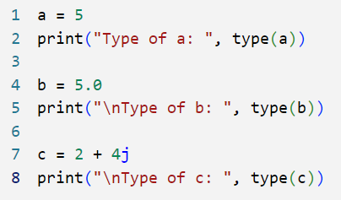
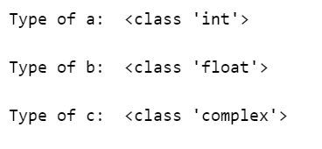
Numeric Data Types (Contd …)
Examples of Numeric Data Types:
To identify the data types of variables in Python, utilizing the type() function.
It returns the data types of variables.
The resulting output displays the specific data type for each variable in Python.
Notes:
Numeric Data type in Python
To find the data types of variables in Python, we use the type() function.
This function outputs the data type of any variable we pass to it.
For example, let’s look at this code:
a = 5
print("Type of a: ", type(a))
Here, we assign the integer value 5 to the variable a and use the type() function to display its data type. The output will be:
Type of a: <class 'int'>
Next, we have:
b = 5.0
print("\nType of b: ", type(b))
In this case, we assign the floating-point value 5.0 to the variable b. The type() function will show:
Type of b: <class 'float'>
Finally, let's see a complex number example:
c = 2 + 4j
print("\nType of c: ", type(c))
Here, c is a complex number. When we check its type, the output will be:
Type of c: <class 'complex'>

Slide 36
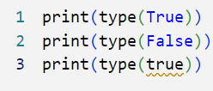
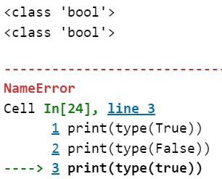
Boolean Data Type
Represents one of two built-in values: True or False.
Represented by the bool class.
Note:
Use capital T for True and capital F for False.
Lowercase true and false will result in an error.
Notes:
Boolean Data type in Python
Boolean data type is essential for control flow and decision-making in your programs.
A Boolean represents one of two built-in values: True or False.
In Python, non-Boolean objects can also be evaluated in a Boolean context to determine their truthiness or falseness.
For example, empty structures like [], {}, and "" are considered False, while non-empty structures are truthy.
Class Representation: Booleans are represented by the bool class in Python.
Important Note
Always use a capital T for True and a capital F for False. Using lowercase true and false will result in an error.
Example
Here’s how you can check the type of Boolean values and see what happens if you use incorrect capitalization:
print(type(True)) # This will print: <class 'bool'>
print(type(False)) # This will print: <class 'bool'>
print(type(true)) # This will raise a NameError because 'true' is not defined
In this example, the first two lines will correctly identify True and False as Boolean values. However, the third line will cause an error because Python is case-sensitive, and true with a lowercase 't' is not recognized as a valid Boolean value.

Slide 37
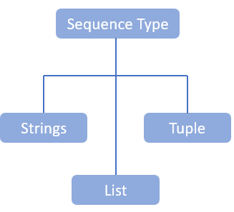
Sequence Data Types
Ordered collection of similar or different types of data.
Stores multiple values in an organized and efficient manner.
String
Notes:
Sequence Data type in Python
Sequence data types allow us to store multiple values in an organized and efficient manner. These types are essential for handling ordered collections of data, which can be either similar or different. This makes it easy to manage and manipulate groups of related data.
Types of Sequence Data Types:
String: A string is a sequence of characters. For example, text = "Hello, World!" is a string.
List: A list is an ordered collection of items which can be of different types. Lists are mutable, meaning you can change their content. For example, my_list = [1, "apple", 3.14, True].
Tuple: A tuple is similar to a list but is immutable, meaning once it is created, its content cannot be changed. For example, my_tuple = (1, "apple", 3.14, True).

Slide 38
Lab Activity
Hands On
Lab 2
Basic operations of Python Programming

Slide 39
Conditional Statements in Python
Conditional statements in Python allow you to make decisions in your code based on specific conditions. They check if a condition is True or False and execute code accordingly.
The main types of conditional statements in Python are:
if statement
if-else statement
if-elif-else statement
nested if statement
Notes:
Conditional Statements in Python
A conditional statement is used to handle conditions in your program. These statements guide the program while making decisions based on the conditions encountered by the program. A conditional statement as the name suggests itself, is used to handle conditions in your program. These statements guide the program while making decisions based on the conditions encountered by the program.
Note:
While using conditional control statements or decision making in Python:
In Python, it is not mandatory to use parenthesis for writing the conditions.
Don’t use the curly braces to define a block because Python uses indentation.
Always use a colon character(:) after writing the conditions.
Here we will discuss only the if statement and the if-else statement.

Slide 40
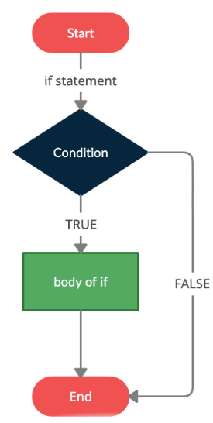
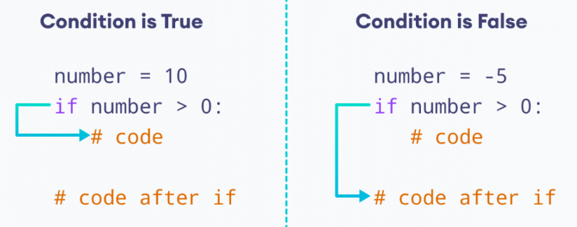
Python if Statement
These conditional tasks can be achieved using the if statement
Syntax
if condition:
# body of if statement
Source :
https://www.toppr.com/
Notes:
Python if Statement
The if statement is a fundamental control flow statement in Python that allows you to execute a block of code conditionally.
It evaluates a condition (an expression that returns True or False) and executes the associated block of code if the condition is True.
Note – The indentation of the body of the loop in Python indicates the content of the if statement. It is necessary to indent the content after the ‘if statement’ has been declared. The body begins with an indentation and ends with the first unindented line.
Steps in the Flowchart:
Start: The program starts execution.
Evaluate if Condition: The condition inside the if statement is checked.
If the condition is True, the code inside the if block is executed.
If the condition is False, the if block is skipped.
Execute Code (if condition is True): The program runs the block of code inside the if statement if the condition is True.
End: After the if statement is processed, the program continues with the rest of the code.
Explanation code :
The condition number > 5 is evaluated.
Since 10 is greater than 5, the condition is True.
The statement inside the if block is executed and "The number is greater than 5." is printed.
Example Code:
# Python program to illustrate different if conditions
age = 16
limit = 25
if (age == 16):
print('Age is correct as mentioned')
if (age < 25):
print('Below age')
if (age > 10):
print('Teen')
if (age <= limit):
print('Under age limit')
if (age >= limit): # will not be printed because the condition is FALSE
print('Above limit’)
Output
Age is correct as mentioned
Below age
Teen
Under age limit

Slide 41
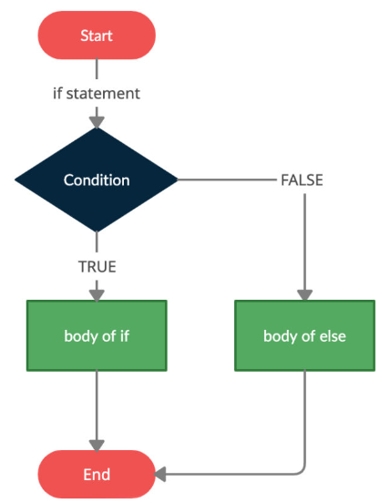
Python if...else Statement
An if statement can have an optional else clause.
The else statement executes only if the condition in the if statement evaluates to False.
Syntax
if condition:
# body of if statement
else:
# body of else statement
Source :
https://www.toppr.com/
Notes:
Python if...else Statement
Here, if the condition inside the if statement evaluates to
True - the body of if executes, and the body of else is skipped.
False - the body of else executes, and the body of if is skipped
Steps in the Flowchart:
Start: The program begins execution.
Evaluate if Condition: The program checks the condition inside the if statement.
If the condition is True, the code inside the if block is executed.
If the condition is False, the code inside the else block is executed.
Execute Block: The program runs the code in either the if block (if the condition is True) or the else block (if the condition is False).
End: After executing the appropriate block, the program continues with the rest of the code outside the if...else structure.
Example:
Code
# Python program to compare between subject marks
history = 45
science = 57
if (history > science):
print('History marks greater than Science')
else:
print('Science marks greater than History’)
Output:
Science marks greater than History
In the above example, if the history marks are greater than science marks, the if condition will be satisfied i.e. TRUE and the corresponding print statement will be executed. If the ‘if condition’ does not satisfy i.e. FALSE, then the body of the else loop will be executed.

Slide 42
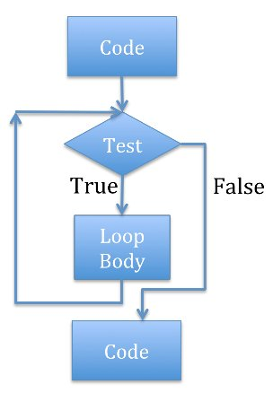
Definition of Iteration
Iteration, in programming, is the process of repeating a set of instructions either for a specific number of times or until a particular condition is satisfied.
This can be through the use of loops, which execute a block of code repeatedly as long as the condition holds true.
Importance of Iteration in Executing Repetitive Tasks
Efficiency and Productivity
Handling Large Data Sets
Dynamic and Flexible Code
Automation
Algorithm Implementation
Source :
https://www.rookieslab.com/posts/iteration-or-loop-in-python
Notes:
Iteration in Programming: Explanation and Example
Iteration in programming refers to the process of repeating a set of instructions multiple times, either for a specified number of iterations or until a particular condition is met. This process is commonly achieved using loops, which allow a block of code to be executed repeatedly as long as a condition remains true.
Common Types of Loops:
For loop: Repeats a block of code a set number of times.
While loop: Repeats a block of code as long as a specified condition is true.
Importance of Iteration in Executing Repetitive Tasks
Efficiency and Productivity: Iteration allows for tasks that would otherwise be manually repetitive to be handled automatically, saving time and reducing human error. For example, instead of manually processing hundreds of elements, a loop can execute the same operation on all elements.
Handling Large Data Sets: When working with large amounts of data, iteration becomes essential. A loop can quickly process each item in a dataset, whether it involves calculations, sorting, or filtering.
Dynamic and Flexible Code: Iteration allows programmers to write code that adapts to changing inputs. Instead of hardcoding specific instructions for different scenarios, a loop can handle multiple cases based on conditions.
Automation: Repetitive tasks like reading files, sending emails, or updating records can be automated with loops, which improves overall system efficiency and reduces manual intervention.
Algorithm Implementation: Many algorithms rely heavily on iteration. For instance, searching through data, sorting algorithms, or even machine learning training loops require repetitive execution to achieve results.

Slide 43
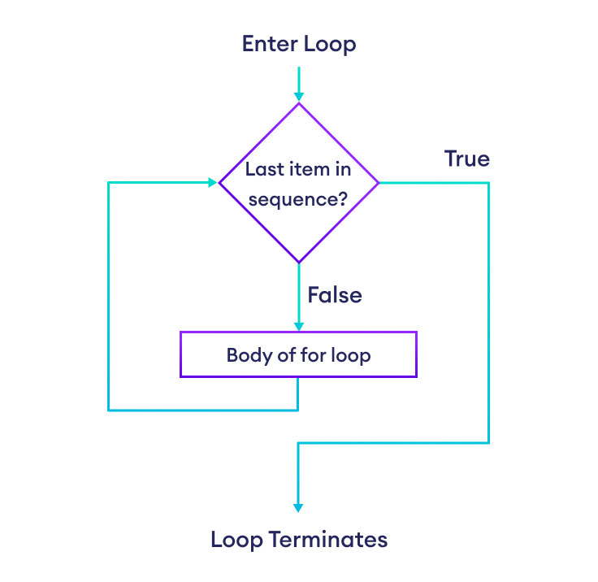
For Loop
A for loop in Python is used for iterating over a sequence (like a list, tuple, dictionary, set, or string) or any other iterable object. It is the most common way to iterate through elements in a collection.
Basic Syntax
for item in iterable:
# Code block to execute
Source :
https://www.programiz.com/python-programming/while-loop/
Notes:
For Loop
The for loop in Python is used to iterate over elements of a sequence, such as a list or a range of numbers. It allows you to execute a block of code multiple times with each item in the sequence.
For example, for i in range(5): print(i) prints numbers from 0 to 4. It’s ideal for tasks where you need to process or repeat actions for a set of items.
Example 1: Iterating Over a List
fruits = ['apple', 'banana', 'cherry']
for fruit in fruits:
print(fruit)
This loop iterates over the list of fruits and prints each one.
Example 2: Iterating Over a String
for char in "hello":
print(char)
This loop iterates over each character in the string "hello" and prints it.
Practical Examples
Example 1: Summing Numbers in a List
numbers = [1, 2, 3, 4, 5]
total = 0
for num in numbers:
total += num
print("Sum:", total)
Example 2: Finding Even Numbers
numbers = [1, 2, 3, 4, 5, 6, 7, 8, 9, 10]
even_numbers = []
for num in numbers:
if num % 2 == 0:
even_numbers.append(num)
print("Even numbers:", even_numbers)

Slide 44
For Loop with range() in Python
The range() function in Python is often used in conjunction with for loops to generate a sequence of numbers. This is useful when you want to iterate over a specific number of times or create a loop that uses numerical indices.
Basic Syntax of range()
start: The starting value of the sequence (inclusive). Defaults to 0 if not provided.
stop: The end value of the sequence (exclusive).
step: The difference between each number in the sequence. Defaults to 1 if not provided
range(stop)
range(start, stop)
range(start, stop, step)
Notes:
For loop with range() Function in Python
The range() function in Python is a built-in function that generates a sequence of numbers. It's often used with for loops to specify how many times the loop should run or to iterate over a series of numbers. This is especially useful when we want to perform actions a specific number of times or when numerical indices are needed in a loop.
Syntax of range():
range(start, stop, step)
Here:
start (optional): The number at which the sequence starts. By default, it starts at 0.
stop: The number at which the sequence ends (this number is not included).
step (optional): The difference between each number in the sequence. By default, the step is 1.

Slide 45
For Loop with range() in Python
Example 1: Using range(stop)
for i in range(5):
print(i)
This loop prints numbers from 0 to 4. Here, range(5) generates the sequence [0, 1, 2, 3, 4].
Example 2: Using range(start, stop)
for i in range(2, 7):
print(i)
This loop prints numbers from 2 to 6. Here, range(2, 7) generates the sequence [2, 3, 4, 5, 6].
Example 3: Using range(start, stop, step):
for i in range(1, 10, 2):
print(i)
This loop prints numbers 1, 3, 5, 7, and 9. Here, range(1, 10, 2) generates the sequence [1, 3, 5, 7, 9].
Notes:
The range() function returns a sequence of numbers, starting from 0 by default, and increments by 1 (by default), and stops before a specified number.
Example 1: Using range(stop)
range(5) generates numbers starting from 0 up to (but not including) 5. This means it will generate the numbers 0, 1, 2, 3, and 4.
The loop will iterate through each of these numbers and print them.
Example 2: Using range(start, stop)
The range(start, stop) format is commonly used when you need to start the sequence from a specific number other than 0.
start: The starting number of the sequence (inclusive).
stop: The ending number of the sequence (exclusive).
range(2, 7) generates numbers starting from 2 up to (but not including) 7. This means it will generate the numbers 2, 3, 4, 5, and 6.
The loop will iterate through each of these numbers and print them.
Example 3: Using range(start, stop, step):
range(1, 10, 2) generates numbers starting from 1 up to (but not including) 10, with a step of 2. This means it will generate the numbers 1, 3, 5, 7, and 9.
The loop will iterate through each of these numbers and print them.

Slide 46
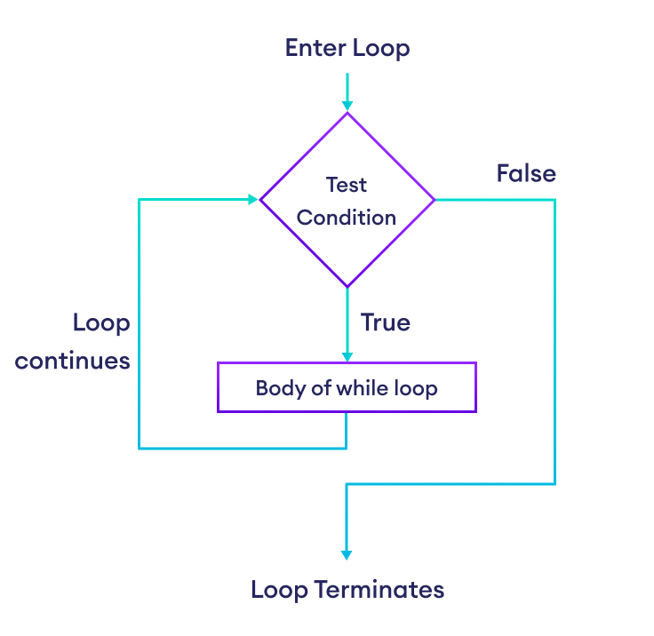
While Loop
A while loop in Python repeatedly executes a block of code as long as a specified condition is true. It is particularly useful when the number of iterations is not known beforehand and the loop needs to continue until a certain condition changes.
Basic Syntax
while condition:
# Code block to execute
Source :
https://www.programiz.com/python-programming/while-loop/
Notes:
While loop in Python
Python consists of two types of loops, namely for loop and while loop. A while loop is categorized as a kind of indefinite iteration. This basically means that in a python while loop, we cannot predict the number of times it will be executed. It can sometimes even be thought of as a reiterating if statement.
Let us discuss the while loop in detail.
Steps in the Flowchart:
Start: The program begins execution.
Evaluate Condition: The while loop condition is checked.
If the condition is True, the program proceeds to execute the loop body.
If the condition is False, the loop terminates, and the program moves to the next part of the code.
Execute Loop Body: The code inside the loop is executed when the condition is True.
Update Condition: The condition inside the while loop may be updated (e.g., incrementing a counter). After executing the loop body, the program goes back to the condition check.
End: Once the condition becomes False, the loop ends, and the program continues with the code following the loop.
Example:
Code:
counter = 0
while counter < 5: # Loop continues as long as counter is less than 5
print(f"Counter is at {counter}")
counter += 1 # Increment counter to avoid infinite loop

Slide 47
While Loop
Example 1: Basic While Loop
count = 0
while count < 5:
print(count)
count += 1
In this example, the loop will execute as long as the count is less than 5. With each iteration, the count is incremented by 1, and its value is printed.
Example 2: Using a While Loop with User Input
user_input = ''
while user_input.lower() != 'quit':
user_input = input("Enter something (type 'quit' to stop): ")
print("You entered:”,user_input)
Here, the loop continues to prompt the user for input until the user types 'quit'. The input is printed back to the user on each iteration.
Notes:
Examples of While Loop
The while loop is a fundamental control flow statement in Python that repeatedly executes a block of code as long as a specified condition is true.
Unlike the for loop, which iterates over a sequence of elements, the while loop continues based on a condition, making it ideal for situations where the number of iterations is not predetermined.
Explanation:
The loop starts with count equal to 1.
The condition count <= 5 is checked before each iteration.
Inside the loop, count is printed and then incremented by 1.
The loop stops when count exceeds 5.
Ex 2- Explanation:
The loop runs indefinitely (while True) until a valid input is received.
The input() function captures user input.
user_input.isdigit() checks if the input is a digit (i.e., it does not contain any non-numeric characters).
int(user_input) > 0 ensures the number is positive.
The loop breaks if a valid number is entered; otherwise, an error message is displayed, and the loop continues.

Slide 48
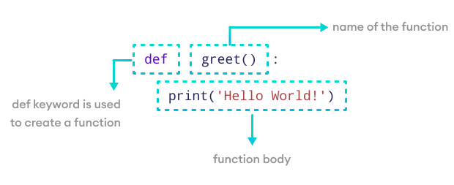
Function in Python
Functions are reusable blocks of code that perform specific tasks. They help organize code, make it easier to understand, and reduce redundancy. Functions in Python are defined using the `def` keyword, followed by a function name and parentheses.
Benefits of Using Functions
Enhances Code Readability
Promotes Code Reusability
Source :
https://www.programiz.com/sites/tutorial2program/files/create-function-python.png
Notes:
Functions in Python: Detailed Explanation
Functions in Python are essential programming constructs that allow you to group a set of instructions to perform specific tasks. They provide structure and organization to your code by breaking complex operations into smaller, reusable blocks. Defined using the def keyword, a function has a name, may accept input parameters, and can return an output.
Benefits of using functions
Enhances Code Readability
Code readability refers to how easily a person can read and understand a piece of code. Functions play a key role in improving this by allowing developers to organize complex code into smaller, meaningful, and manageable blocks.
Breaking Down Complex Problems: When you face a complex problem, solving it as one large piece of code can be difficult and confusing. By using functions, you can break the problem into smaller tasks, and each task can be assigned to a separate function. This makes the code more readable and easier to debug.
Descriptive Function Names: Giving your functions meaningful and descriptive names further improves readability. When others (or you) read the code later, the purpose of each function is clear just from the name. Instead of diving into the implementation details, you can quickly grasp the logic by looking at the function calls.
Abstraction: Functions abstract the "how" and let you focus on the "what". Once a function is created, you can use it without needing to know the details of how it works. This abstraction is especially useful in large projects where different team members may handle different parts of the code.
Promotes Code Reusability
Code reusability refers to the practice of using the same code for different purposes without having to rewrite it each time. Functions in Python enable this by allowing you to define a piece of code once and reuse it multiple times across your program.
Avoid Redundancy: Instead of writing the same code in multiple places, you can encapsulate that logic in a function and call it whenever needed. This makes your code more efficient and less error-prone. If the logic needs to be updated, you only have to change the function definition rather than updating multiple parts of the code.
Ease of Maintenance: When you use functions, maintaining and updating your code becomes easier. If there’s an error in a function or if the logic changes, you can fix it in one place, and the changes will automatically reflect everywhere the function is called.
Simplifies Complex Logic: In scenarios where your code needs to perform complex operations, wrapping that logic in a function makes it easy to reuse in different contexts. You avoid having to rewrite complex logic multiple times, reducing the chances of bugs and improving performance.
Modular Design: Functions encourage a modular design approach, where you build your program as a collection of smaller, independent functions. Each function serves a specific purpose and can be reused in different parts of the program without rewriting code. This also makes it easier to test individual functions for correctness.

Slide 49
Lab Activity
Hands On
Lab 3
Python program with Loop and control statements

Slide 50
Type of Function in Python
Built-in Functions
These are functions that are pre-defined and provided by Python. You can use them directly without needing to define them yourself.
Examples:
print(): Outputs data to the console.
len(): Returns the length of an object like a list, string, etc.
type(): Returns the type of an object.
2. User-defined Functions
Functions that you define yourself to perform specific tasks.
Syntax:
def function_name(parameters):
#Function body
return value # (Optional)
Notes:
Type of Function of Python
In Python, functions are a fundamental part of the language that allow you to encapsulate code into reusable blocks. Functions in Python can be categorized based on their structure, usage, and how they are defined.
Built-in Functions: Predefined in Python, available without any imports.
User-defined Functions: Defined by the user for specific tasks.
Built-in Function
Built-in functions in Python are predefined functions that are part of the Python standard library. These functions are always available and do not require any import statements or additional code to use. You can call them directly without needing to define them yourself.
Examples:
print(): This function outputs data to the console. It is one of the most frequently used built-in functions. print("Hello, World!")
len(): This function returns the length (the number of items) of an object like a list, string, tuple, or other iterable. It helps you quickly determine how many elements are in a container. my_list = [1, 2, 3, 4] print(len(my_list)) # Output: 4
type(): This function returns the type of an object, which is useful when you want to check the data type of a variable or object. x = 10 print(type(x)) # Output: <class 'int’>
User-defined functions
User-defined functions are functions that you create yourself to perform specific tasks or operations in your program. Unlike built-in functions, these are custom-made and serve specific needs within your code. They help organize your code into manageable chunks, especially when solving complex problems.
Example:
def add_numbers(a, b):
result = a + b
return result
# Calling the function
sum_result = add_numbers(5, 3)
print(sum_result) # Output: 8
In this example, add_numbers is a user-defined function that takes two parameters, a and b. It adds them together and returns the result.

Slide 51
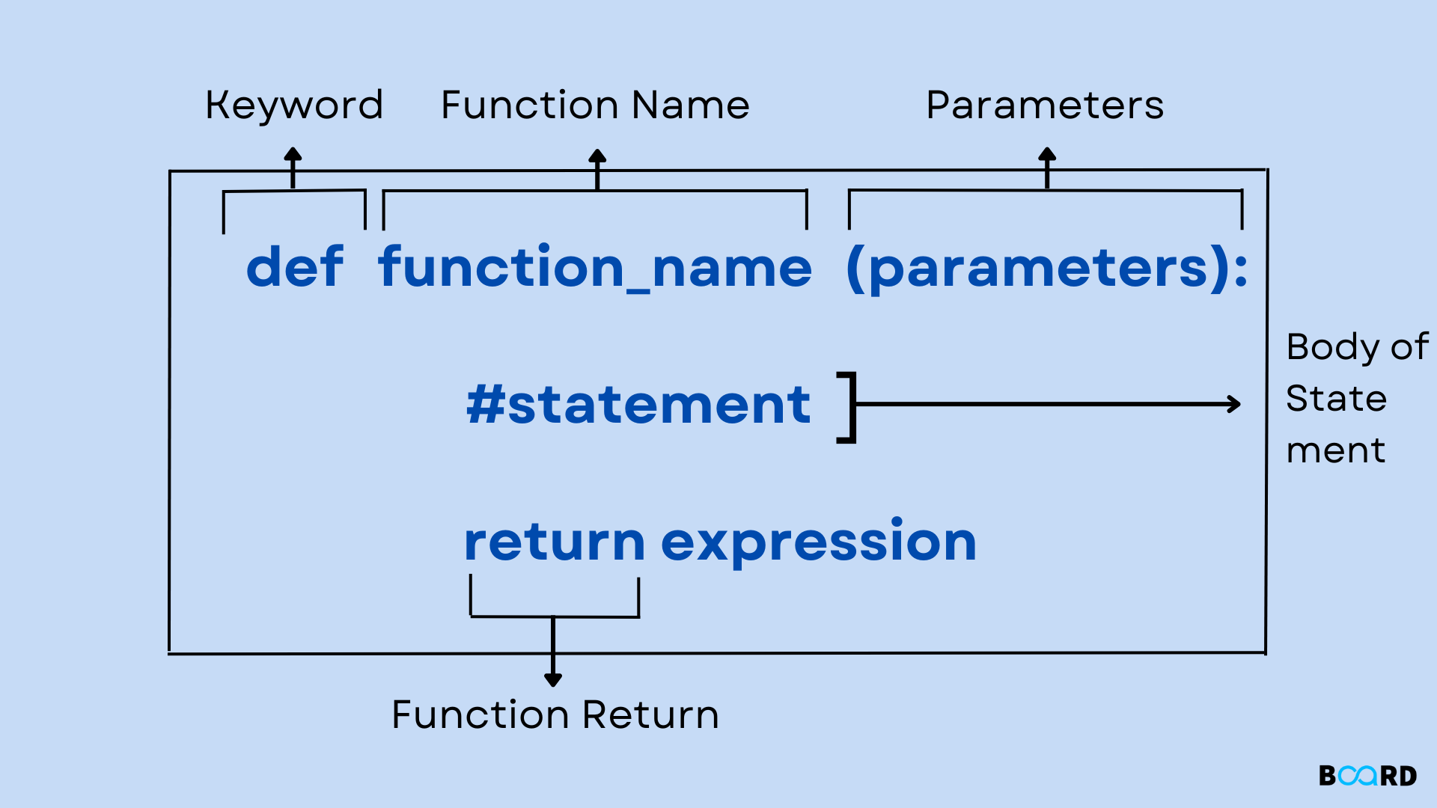
Function Definition
The python def keyword is used to define a function; it is placed before a function name that is provided by the user to create a user-defined function.
def function_name(parameters):
"""docstring"""
statement(s)
return value
Here’s the definition of a simple function, hello
def hello():
"""This function says hello and greets you"""
print("Hello")
print("Glad to meet you")
Source :
https://www.boardinfinity.com/blog/functions-in-python/
Notes:
Functions in Python: A Detailed Explanation
In Python, functions are a core programming construct that allow you to group a set of instructions into a reusable block of code. Functions make your code more organized, efficient, and modular. By defining a function, you can execute a specific task multiple times without having to rewrite the code.
A function in Python is defined using the def keyword, followed by a function name, a list of optional parameters in parentheses, and a code block that performs the function's tasks. Optionally, a function can return a value to the caller using the return statement.
Basic Syntax:
def function_name(parameters):
# Code block
return value # Optional
Key Components of a Function
1. def Keyword: The def keyword is used to define a new function in Python. It tells the interpreter that a function is being created.
Example:
def greet():
print("Hello, World!")
2. Function Name: The function's name should be descriptive and give a clear indication of what the function does. This makes the code more readable and maintainable. The naming convention usually follows snake_case (lowercase words separated by underscores).
Example:
def calculate_sum():
pass # Placeholder for the function code
3. Parameters: Parameters (also called arguments) are variables that you can pass into the function when you call it. They allow the function to perform operations on different inputs. Parameters are optional — if the function doesn't need any inputs, parentheses can be left empty.
Example with parameters:
def greet(name):
print("Hello ”, name)
When the function greet("Alice") is called, "Alice" is passed as the parameter name, and the output will be:
Hello, Alice!
4. Code Block: The code block is the indented part of the function definition that contains the logic of the function. This is the part of the function that gets executed when the function is called. Proper indentation is required in Python to define the scope of the code block.
Example:
def add_numbers(a, b):
result = a + b # Code block to add two numbers
print(result)
5. Return Statement: The return statement is used to send the result of the function back to the part of the code that called the function. It is optional, but very useful when you want the function to output a value for further processing.
Example with a return statement:
def multiply(a, b):
return a * b
In this example, the function multiply(3, 4) will return 12, which can be used in other parts of the code.

Slide 52
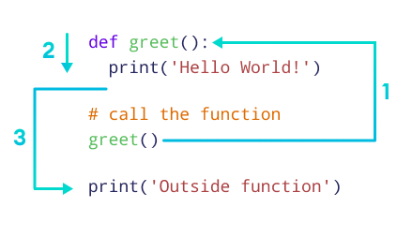
Calling a Function
Python Function Call code
def greet():
print('Hello World!')
# call the function
greet()
print('Outside function’)
Once you have defined a function, you can call it in your code as many times as you need.
Source :
https://www.programiz.com/sites/tutorial2program/files/create-function-python.png
Notes:
Calling a Function
Once you have defined a function in Python, such as `def greet():` which prints 'Hello World!', you can call this function in your code whenever needed.
To call the function, simply type its name followed by parentheses, as shown with `greet()`. This will execute the function and display 'Hello World!' each time it is called.
After the function call, you can continue with other code, like printing 'Outside function'. If your function requires arguments, you include them within the parentheses. This allows you to reuse the function as many times as necessary throughout your code, promoting efficiency and modularity.
Note:
When the function greet() is called, the program's control transfers to the function definition.
All the code inside the function is executed.
The control of the program jumps to the next statement after the function call.
Example :
def add(x, y):
"""Function to add two numbers"""
return x + y
def subtract(x, y):
"""Function to subtract one number from another"""
return x - y
def multiply(x, y):
"""Function to multiply two numbers"""
return x * y
def divide(x, y):
"""Function to divide one number by another"""
if y == 0:
return "Error! Division by zero."
return x / y
def main():
"""Main function to handle user input and call operations"""
print("Select operation:")
print("1. Add")
print("2. Subtract")
print("3. Multiply")
print("4. Divide")
choice = input("Enter choice(1/2/3/4): ")
if choice in ['1', '2', '3', '4']:
num1 = float(input("Enter first number: "))
num2 = float(input("Enter second number: "))
if choice == '1':
print(f"The result is: {add(num1, num2)}")
elif choice == '2':
print(f"The result is: {subtract(num1, num2)}")
elif choice == '3':
print(f"The result is: {multiply(num1, num2)}")
elif choice == '4':
print(f"The result is: {divide(num1, num2)}")
else:
print("Invalid Input")
# Call the main function to start the program
if __name__ == "__main__":
main()

Slide 53
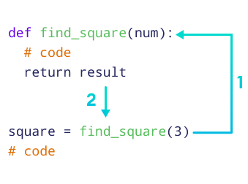
The return Statement in a Function
The return statement in Python is used to exit a function and send a value back to the caller.
When a function executes a return statement, it immediately stops executing and outputs the specified value.
# function definition
def find_square(num):
result = num * num
return result
# function call
square = find_square(3)
print('Square:', square)
Source :
https://www.programiz.com/sites/tutorial2program/files/create-function-python.png
Notes:
The return statement in Python is used to exit a function and send a value back to the caller. When a function executes a return statement, it immediately stops executing and outputs the specified value. This value can then be used or stored in the code that called the function.
In the mentioned example, we define a function named `find_square` with the purpose of calculating the square of a given number.
The function takes a single parameter, `num`, and calculates its square by multiplying `num` by itself, storing the result in the variable `result`.
The `return` statement then outputs this result. To use this function, we call it with an argument, such as `find_square(3)`, and store the returned value in the variable `square`.
Finally, we print the result with the statement `print('Square:', square)`, which will display 'Square: 9' in this case. This demonstrates how to define a function, call it with an argument, and use its return value in your code.
Note: The return statement also denotes that the function has ended. Any code after return is not executed.
Here's a practical example of using the return statement to determine the grade based on a score:
def get_grade(score):
if score >= 90:
return 'A'
if score >= 80:
return 'B'
if score >= 70:
return ‘C’
if score >= 60:
return 'D'
else:
return 'F'
print(get_grade(95)) # Output: A
print(get_grade(85)) # Output: B
print(get_grade(75)) # Output: C
print(get_grade(65)) # Output: D
print(get_grade(55)) # Output: F
In this example, the get_grade function uses the return statement to return a letter grade based on the input score. The function exits as soon as it hits a return statement that satisfies the condition.

Slide 54
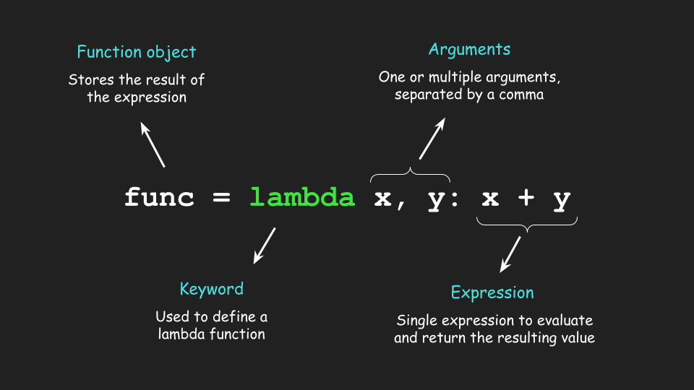
Lambda Function
A lambda function is a small anonymous function.
A lambda function can take any number of arguments but can only have one expression.
Syntax
lambda arguments : expression
The expression is executed and the result is returned:
Example: Add 10 to argument a, and return the result:
x = lambda a : a + 10
print(x(5))
Source :
https://towardsdatascience.com/how-to-effectively-use-lambda-functions-in-python-as-a-data-scientist-fd6171554053
Notes:
A lambda function in Python is a small, anonymous function that is defined using the lambda keyword. Unlike regular functions defined with def, lambda functions are usually limited to a single expression and can take any number of arguments. They are often used for short, simple tasks that don't require the full structure of a standard function.
Syntax
The syntax of a lambda function is:
lambda arguments: expression
arguments: The parameters the lambda function will accept.
expression: The result returned from the function, usually a single expression.
Characteristics of Lambda Functions:
Anonymous: They don't require a function name, hence called "anonymous."
Single Expression: Lambda functions are limited to a single expression, and they implicitly return the result of the expression.
Compact: Lambdas are typically used in places where a full function definition would be overkill, especially when the function is small and simple.
Example: Basic Lambda Function
Here's a simple lambda function that adds two numbers:
add = lambda x, y: x + y
print(add(3, 5)) # Output: 8
In this example, lambda x, y: x + y is a lambda function that takes two arguments, x and y, and returns their sum. The add variable holds the lambda function and can be called just like a regular function.
Use Cases of Lambda Functions:
Lambda functions are commonly used in conjunction with functions that take other functions as arguments, such as map(), filter(), and sorted().

Slide 55
Lab Activity
Hands On
Lab 4
Python program using function and return

Slide 56

Introduction to Pandas
What is Pandas?
Pandas is an open-source data manipulation and analysis library.
Built on top of NumPy.
Provides two main data structures: Series and DataFrame.
Series is a one dimensional array and DataFrame is two dimensional.
Key Features:
High-level data manipulation tools.
Data cleaning, transformation, and aggregation.
Merging and joining of datasets.
Source :
https://www.scaler.com/topics/architecture-of-data-warehouse/
Notes:
What is Pandas?
Pandas is an open-source library specifically designed for data manipulation and analysis, widely used in Python programming. It’s a powerful tool that enables data scientists and analysts to work efficiently with large datasets, offering an array of versatile tools for handling, cleaning, and analyzing data.
Foundation on NumPy: Pandas is built on top of another core library in Python, called NumPy, which provides support for large multi-dimensional arrays and matrices. NumPy helps with high-performance operations, and Pandas utilizes these features to enable fast, efficient data manipulation.
Key Data Structures:
Pandas provides two main data structures that allow us to work with data in different formats:
Series: A one-dimensional labeled array that can hold any data type (integers, strings, floats, etc.). Think of it as a single column in a spreadsheet or database.
DataFrame: A two-dimensional, size-mutable, and heterogeneous tabular data structure. You can think of it as a complete spreadsheet or table with labeled axes (rows and columns).
Key Features of Pandas:
High-level data manipulation tools: Pandas provides a set of powerful tools for reshaping, sorting, and filtering data, making it simpler to conduct data analysis.
Data Cleaning, Transformation, and Aggregation: With Pandas, you can handle missing data, perform calculations, modify data formats, and aggregate data to gain insights.
Merging and Joining Datasets: Pandas makes it easy to merge and join data from multiple sources, which is essential in real-world analysis where data may come from different files, databases, or APIs.

Slide 57
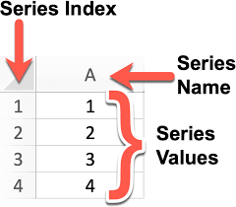
Pandas Series
Pandas Series is a labelled one-dimensional array that can hold any type of data (integer, string, float, Python objects, and so on).
Pandas Series is simply a column in an Excel spreadsheet.
Using the Series() method, we can easily convert a list, tuple, or dictionary into a Series.
Source :
https://codechalleng.es/bites/251/
Notes:
Pandas Series
A Pandas Series is a labeled one-dimensional array capable of holding any type of data, such as integers, strings, floats, or even complex Python objects. Think of a Pandas Series as being similar to a single column in an Excel spreadsheet—it provides both values and labels (or indexes) for each entry, making data organization simple and accessible.
Key Points about Pandas Series:
Versatile Data Types: A Series can contain different types of data within one column, making it flexible for various kinds of data analysis and manipulation.
Intuitive Labeling: Each entry in a Series has an associated index label. This indexing helps to quickly access, manipulate, and retrieve specific elements from the Series. Labels can be default numerical values (0, 1, 2, etc.) or custom labels as defined by the user.
Creating a Pandas Series with Series() Method:
The Series() method allows us to easily convert other data structures, like lists, tuples, or dictionaries, into a Series object:
From a list or tuple: The elements become values in the Series, with default numeric indexing.
From a dictionary: Keys of the dictionary become the index labels of the Series, while the values become the entries in the Series.

Slide 58
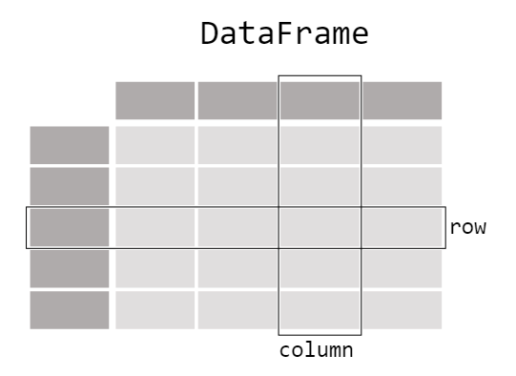
Pandas DataFrame
Panda has A two-dimensional data structure with corresponding labels is known as a dataframe.
Spreadsheets used in Excel or Calc or SQL tables are similar to DataFrames.
Pandas DataFrame consists of three main components: the data, the index, and the columns.
Source :
https://pandas.pydata.org/docs/getting_started/intro_tutorials/01_table_oriented.html
Notes:
Pandas DataFrame
A Pandas DataFrame is a core data structure in the Pandas library and one of the most versatile tools for handling data in Python. It’s a two-dimensional data structure with labeled rows and columns, making it similar to a table in a SQL database, an Excel spreadsheet, or a Google Sheet.
Key Characteristics of a DataFrame:
Two-Dimensional Format: DataFrames are structured with both rows and columns, allowing users to store and manipulate complex datasets in a structured way. Each row and column is labeled, enabling easy access to specific data points.
Intuitive Similarity to Common Data Formats: The structure of a DataFrame is similar to common data formats, like spreadsheets or SQL tables, making it easier to grasp for users already familiar with these tools.
Three Main Components of a DataFrame:
Data: The actual data stored in the DataFrame, which can include multiple data types—strings, integers, floats, or even more complex data types.
Index: The labels assigned to rows, which help uniquely identify each row. Indexing provides flexibility for quick data access and retrieval.
Columns: Each column has a unique label, allowing easy reference, filtering, and sorting by specific data points.
Creating and Working with DataFrames: DataFrames can be created from various sources, including lists of lists, dictionaries of lists, external CSV files, SQL databases, or even directly from other DataFrames. This adaptability makes DataFrames ideal for data analysis, exploration, and manipulation.

Slide 59
Pandas Applications
Data Handling:
Importing data from various file formats (CSV, Excel, SQL databases).
Handling missing data.
Data Wrangling:
Filtering, grouping, merging, and reshaping data.
Exploratory Data Analysis:
Descriptive statistics and data visualization support.
Notes:
Applications of Pandas
Pandas is an essential library for data science and analytics, with applications that span several key areas. Here’s a breakdown of its primary uses:
Data Handling:
Importing Data: Pandas can import data from various sources and formats, including CSV files, Excel spreadsheets, SQL databases, and even JSON files. This versatility simplifies working with data from different systems and makes it easy to integrate data sources for analysis.
Handling Missing Data: In real-world data, missing values are common. Pandas provides tools to identify, fill, replace, or drop missing data, making it easier to clean datasets and prepare them for analysis.
Data Wrangling:
Filtering and Grouping: Pandas offers intuitive ways to filter data based on conditions, and group data by specific columns to obtain insights from different segments within a dataset.
Merging and Joining: You can merge or join multiple datasets based on shared keys or indexes, which is valuable when working with related data from multiple sources.
Reshaping Data: Pandas allows data reshaping through pivoting, stacking, and unstacking, which helps to reorganize data to fit analysis needs better.
Exploratory Data Analysis (EDA):
Descriptive Statistics: Pandas provides quick access to summary statistics like mean, median, min, max, and standard deviation, which helps understand data distributions and identify outliers.
Data Visualization Support: Though Pandas isn’t a dedicated visualization library, it integrates with Matplotlib and Seaborn for visualizing data, enabling quick, simple charts directly from DataFrames to visualize trends and patterns in the data.

Slide 60
Lab Activity
Hands On
Lab 5
Exploring Pandas Library

Slide 61
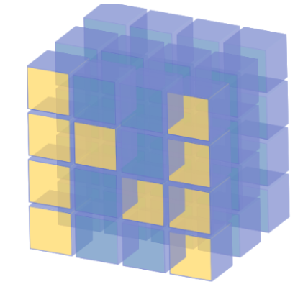
Introduction to NumPy
What is NumPy?
NumPy stands for Numerical Python.
It is a foundational package for numerical computing in Python.
Provides support for large multi-dimensional arrays and matrices.
Key Features:
Efficient handling of numerical data.
A wide array of mathematical functions to operate on these arrays.
Essential for scientific computing and data analysis.
Source :
https://www.scaler.com/topics/architecture-of-data-warehouse/
Notes:
What is NumPy?
NumPy, short for Numerical Python, is one of the core libraries in Python for numerical computing. It’s a foundational package in the data science ecosystem, widely used for performing efficient and fast computations on large datasets. NumPy is designed to handle multi-dimensional arrays and matrices efficiently, which makes it essential for data analysis, machine learning, and scientific computing.
Key Features of NumPy:
Efficient Handling of Numerical Data:
NumPy is optimized for operations on large arrays of data, which are stored in contiguous memory blocks. This setup allows for quick data access and computation, making NumPy much faster for numerical tasks compared to standard Python lists.
Support for Multi-dimensional Arrays:
The array is the central data structure in NumPy, and it can be one-dimensional (vectors), two-dimensional (matrices), or multi-dimensional (tensors). This versatility makes NumPy suitable for complex mathematical operations and multi-dimensional data manipulation.
Comprehensive Mathematical Functions:
NumPy provides a broad range of mathematical functions for array operations, including linear algebra, statistical functions, random sampling, and more. These functions make it easy to perform a wide array of calculations, from basic arithmetic to advanced linear algebra operations.
Essential for Scientific Computing and Data Analysis:
Due to its speed and efficiency, NumPy serves as the backbone of many other Python libraries for scientific computing and data analysis, such as Pandas, Matplotlib, and SciPy. Together, they form a powerful ecosystem for analyzing, visualizing, and working with large-scale data.

Slide 62
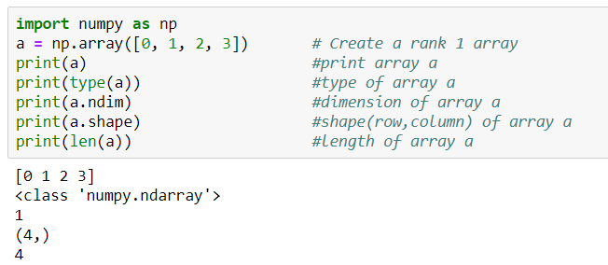
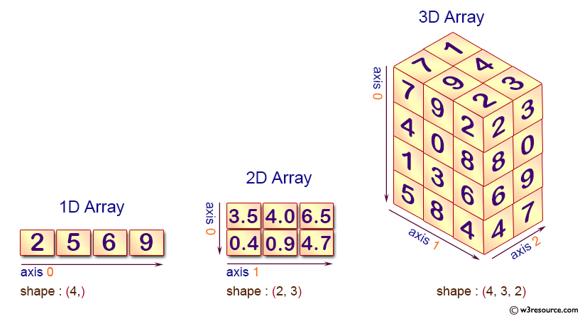
Numpy Array
NumPy array is a multi-dimensional data structure that is the core of scientific computing in Python.
All values in an array are homogenous (of the same data type).
They offer automatic vectorization and broadcasting.
Source :
https://medium.com/byte-sized-code/tagged/numpy
Notes:
NumPy Array
The NumPy array is a multi-dimensional data structure that serves as the foundation for scientific computing in Python. Arrays are the primary way of storing and manipulating numerical data in NumPy, and they are highly optimized for performance, making them essential in data analysis and machine learning.
Key Characteristics of NumPy Arrays:
Homogenous Data: All values within a NumPy array are homogenous, meaning they are of the same data type (e.g., all integers, all floats, etc.). This uniformity makes processing faster and more memory-efficient, as operations can be applied uniformly across all elements.
Multi-Dimensional Structure: Unlike traditional lists in Python, NumPy arrays can be multi-dimensional. This allows you to create arrays of any shape (1D vectors, 2D matrices, or higher-dimensional tensors), making them versatile and powerful for representing complex data structures, such as images or time-series data.
Automatic Vectorization and Broadcasting:
Vectorization: NumPy arrays support automatic vectorization, meaning you can perform mathematical operations on entire arrays without explicit loops. This leads to code that is not only faster but also more concise and readable.
Broadcasting: NumPy’s broadcasting feature enables operations on arrays of different shapes, which simplifies many mathematical operations. For example, you can add a scalar value to an array, or add two arrays of different shapes, without extra code.
Explanation of the code:
This code begins by importing the NumPy library as np, which is a popular library in Python for numerical computations.
It then creates a one-dimensional (rank 1) array a containing the integers 0 through 3.
The code proceeds to print the array a itself, displays its type (which will confirm it's a NumPy array), and checks the number of dimensions using a.ndim, which should return 1 for a one-dimensional array.
Additionally, it retrieves and prints the shape of the array with a.shape, which indicates the size of each dimension; since a is one-dimensional, this will return a tuple with a single value representing the length of the array.
Finally, it prints the length of the array using the built-in len() function, which confirms the number of elements in a, returning 4 in this case.

Slide 63
Working with Numpy array
Create 2-D array using numpy from list
import numpy as np
mylist=[[1,2,3],[4,5,6],[7,8,9]]
np.array(mylist)
Create 1-D and 2-D array using random values
np.random.rand(5) #uniform distribution of random values
np.random.rand(4,4) # create 2-D array of random values
np.random.randn(4) #std. normal distribution, centered around 0
Notes:
Creating a 2-D Array from a List:
The code first imports the NumPy library as np. It then defines a list called mylist, which is a nested list containing three sublists: [1, 2, 3], [4, 5, 6], and [7, 8, 9].
The np.array(mylist) function is used to convert this nested list into a 2-D NumPy array. This results in a 2-D array with three rows and three columns.
Creating Random Arrays:
np.random.rand(5): This function generates a 1-D array of 5 random values drawn from a uniform distribution between 0 and 1.
np.random.rand(4, 4): This generates a 2-D array with 4 rows and 4 columns, filled with random values from a uniform distribution between 0 and 1.
np.random.randn(4): This creates a 1-D array of 4 random values drawn from a standard normal distribution (mean 0 and standard deviation 1).

Slide 64
Commonly used Numpy methods & attributes
np.array(): Creates a NumPy array from a list or other iterable.
np.random.randint(0, 10, 1): Generates a random integer between 0 and 10, with size 1.
np.unique(): Finds the unique elements in an array and returns them in sorted order.
np.dot(): Computes the dot product of two arrays or matrices.
np.power(a, 2): Raises each element of array a to the power of 2.
np.sqrt(a): Returns the square root of each element in the array a.
np.ones(): Creates a new array of the specified shape, filled with ones.
np.zeros(): Creates a new array of the specified shape, filled with zeros.
np.max(): Returns the maximum value in the array.
np.arange(10): Creates an array with evenly spaced values from 0 to 9.
Notes:
Commonly Used NumPy Methods
NumPy provides a variety of methods that are essential for creating and manipulating arrays. Here are some of the most commonly used functions:
np.array():
This function creates a NumPy array from a list or any other iterable. It’s the fundamental method to convert standard Python data structures into NumPy arrays, enabling all the advantages of array operations.
Example: np.array([1, 2, 3]) creates a one-dimensional array with three elements.
np.random.randint(0, 10, 1):
Generates a random integer between 0 and 10, with the specified size. This method is useful for simulations and random sampling.
Example: np.random.randint(0, 10, 1) might produce an output like array([4]).
np.unique():
Finds the unique elements in an array and returns them in sorted order. This is particularly useful for data analysis when you want to identify distinct values.
Example: np.unique([1, 2, 2, 3]) would return array([1, 2, 3]).
np.dot():
Computes the dot product of two arrays or matrices. This is fundamental in linear algebra for various applications, including machine learning algorithms.
Example: np.dot(np.array([1, 2]), np.array([3, 4])) yields 11, which is calculated as 1∗3+2∗41*3 + 2*41∗3+2∗4.
np.power(a, 2):
Raises each element of the array a to the power of 2. This is a convenient way to apply element-wise operations on arrays.
Example: If a = np.array([1, 2, 3]), then np.power(a, 2) results in array([1, 4, 9]).
np.sqrt(a):
Returns the square root of each element in the array a. This is useful for statistical analysis and data transformation.
Example: For a = np.array([1, 4, 9]), np.sqrt(a) would return array([1., 2., 3.]).
np.ones():
Creates a new array of the specified shape, filled with ones. This can be useful for initializing matrices or tensors in computations.
Example: np.ones((2, 3)) creates a 2x3 array filled with ones.
np.zeros():
Similar to np.ones(), this method creates a new array of the specified shape, but filled with zeros. It’s often used to initialize arrays before populating them with data.
Example: np.zeros((2, 3)) generates a 2x3 array filled with zeros.
np.max():
Returns the maximum value in the array. This is helpful for identifying the largest element in datasets.
Example: For a = np.array([1, 5, 3]), np.max(a) would return 5.
np.arange(10):
Creates an array with evenly spaced values from 0 to 9. It’s similar to Python’s built-in range() function but returns a NumPy array instead.
Example: np.arange(10) results in array([0, 1, 2, 3, 4, 5, 6, 7, 8, 9]).

Slide 65
Applications of Numpy
Array Manipulation:
Creation, manipulation, and slicing of arrays.
Mathematical Operations:
Element-wise operations, linear algebra, statistical operations.
Integration with Other Libraries:
Works seamlessly with Pandas, SciPy, and Matplotlib.
Performance:
Optimized for speed, making it ideal for large-scale data analysis.
Notes:
Applications of NumPy
NumPy is an essential library for numerical computing in Python, with a wide range of applications in data analysis, scientific computing, and machine learning. Here are some key areas where NumPy shines:
Array Manipulation:
Creation: NumPy allows for the easy creation of arrays from lists, tuples, or even other arrays. This flexibility makes it straightforward to initialize data structures for various applications.
Manipulation: With NumPy, you can efficiently manipulate arrays by reshaping, merging, or splitting them, enabling complex data transformations.
Slicing: NumPy provides powerful slicing capabilities, allowing users to extract specific portions of arrays. This feature is crucial for data analysis tasks, where you often need to focus on particular subsets of your data.
Mathematical Operations:
Element-Wise Operations: NumPy enables element-wise operations on arrays, allowing you to perform calculations on entire datasets without explicit loops. This leads to cleaner and more efficient code.
Linear Algebra: NumPy provides comprehensive support for linear algebra operations, such as matrix multiplication, determinants, and eigenvalues, which are fundamental in various scientific and engineering applications.
Statistical Operations: The library includes a wide array of statistical functions (mean, median, standard deviation, etc.) that help analyze data distributions and trends, making it essential for data analysis tasks.
Integration with Other Libraries:
NumPy works seamlessly with other popular Python libraries, such as Pandas (for data manipulation), SciPy (for scientific computing), and Matplotlib (for data visualization). This integration enhances its functionality and allows users to leverage the strengths of each library in their data workflows.
Performance:
NumPy is optimized for speed and performance, making it ideal for large-scale data analysis. It uses efficient memory management and vectorized operations, enabling computations to be executed much faster than with traditional Python lists. This efficiency is crucial for handling big data and complex numerical tasks in fields like machine learning, statistics, and scientific research.

Slide 66
Lab Activity
Hands On
Lab 6
Exploring Numpy Library

Slide 67
What is Data Preprocessing?
Data preprocessing is the essential process of transforming raw data into a clean, organized, and usable format suitable for analysis.
It involves cleaning, structuring, and transforming data to ensure data quality and consistency.
The Data Preprocessing Process:
Data preprocessing typically involves four key steps:
Discovery: Understanding the data, identifying its structure, format, and potential issues.
Transformation: Converting data into a suitable format for analysis, including handling missing values, outliers, and inconsistencies.
Validation: Ensuring data accuracy and consistency through checks and verification.
Publishing: Preparing the processed data for analysis and consumption.
Notes:
Data Preprocessing
Data preprocessing is a crucial process that transforms raw data into a clean, organized, and usable format that is suitable for analysis. It lays the foundation for effective data analysis by ensuring that the data is accurate, consistent, and ready for the next steps in any analytical workflow.
Data preprocessing involves several essential tasks that enhance data quality and ensure consistency. Properly preprocessed data improves the reliability of analysis, leading to more accurate insights and better decision-making.
Data preprocessing typically involves four key steps:
Discovery: Understanding the data, identifying its structure, format, and potential issues.
Transformation: Converting data into a suitable format for analysis, including handling missing values, outliers, and inconsistencies.
Validation: Ensuring data accuracy and consistency through checks and verification.
Publishing: Preparing the processed data for analysis and consumption.

Slide 68
Discovery and Transformation Phase
Discovery Phase
Goal: Understand data in context of the use case.
Activities: Clean, structure, organize, and map data.
Outcome: Determine the best approach for data preprocessing.
Transformation Phase
Primary Activities:
Structuring: Organizing data into a specific format.
Normalizing: Adjusting data values to a common scale.
De-normalizing: Converting normalized data into its original format.
Cleaning: Removing or correcting errors.
Enriching: Adding additional information to data.
Notes:
Discovery Phase
The primary goal of the Discovery Phase is to understand the data in the context of the specific use case. This involves gaining insights into the data's characteristics, structure, and potential challenges that might affect analysis.
Activities:
Clean: Identify and address initial data quality issues, such as missing values or outliers that could impact the analysis.
Structure: Determine how the data is organized and whether it is in a suitable format for analysis. This may involve assessing whether the data is in tabular form, time-series format, etc.
Organize: Arrange the data logically to facilitate further processing. This might include categorizing variables or defining the relationships between different datasets.
Map Data: Create a data dictionary or schema that outlines the data types, variable definitions, and relationships among different datasets. This helps clarify how each piece of data contributes to the analysis.
Outcome: The outcome of the Discovery Phase is to determine the best approach for data preprocessing. By thoroughly understanding the data, you can make informed decisions about the methods and techniques that will be most effective for transforming the data into a usable format for analysis.
Transformation Phase
The Transformation Phase focuses on preparing the data for analysis through various techniques.
Key activities include:
Structuring:
Organizing data into a specific format suitable for analysis, such as converting data into tabular formats or creating structured datasets from unstructured sources.
Example: Transforming raw text data into a structured table with columns for different attributes.
Normalizing:
Adjusting data values to a common scale to ensure that no particular feature disproportionately affects the results. This is essential in algorithms sensitive to the scale of input data.
Example: Scaling numerical features to a range between 0 and 1, or standardizing them to have a mean of 0 and a standard deviation of 1.
De-normalizing:
Converting normalized data back into its original format or scale, if needed, to interpret results in a more understandable context.
Example: Converting scaled values back to their original units for reporting or presentation purposes.
Cleaning:
Removing or correcting errors in the data, such as inconsistencies, duplicates, or incorrect values. This is crucial for ensuring the integrity and reliability of the dataset.
Example: Identifying and correcting typos in categorical variables or removing duplicate records.
Enriching:
Adding additional information to the data to provide more context or enhance the analysis. This could involve merging datasets, adding new features, or integrating external data sources.
Example: Combining customer data with demographic information to enrich insights for a marketing analysis.

Slide 69
Validation and Publishing Phase
Validation Phase
Purpose: Evaluate data quality post-transformation.
Validation Rules: Repetitive programming procedures to ensure data accuracy, reliability, and security.
Publishing Phase
Definition: Delivering the processed data for use in projects.
Includes: Transformed and validated data, and metadata.
Notes:
Validation Phase
The Validation Phase is critical for evaluating the quality of data after transformation. This step ensures that the data meets specific standards of accuracy, reliability, and security, making it fit for analysis and decision-making.
Validation Rules:
During this phase, a set of validation rules is applied. These are repetitive programming procedures designed to verify the integrity of the data. Key aspects include:
Accuracy: Ensuring that the data correctly represents the real-world scenarios it is supposed to depict. This may involve cross-checking against known values or validating calculations.
Reliability: Confirming that the data remains consistent and trustworthy across different analyses or datasets. This might include checks for data consistency over time.
Security: Ensuring that sensitive data is handled appropriately, adhering to privacy standards and regulations. This includes checking for unauthorized access and validating that data is stored securely.
Common Validation Techniques:
Automated Scripts: Utilizing scripts to run checks on data quality metrics, such as completeness, validity, and uniqueness.
Statistical Checks: Applying statistical methods to validate distributions and ranges of numerical data.
Peer Review: Involving team members in reviewing the data and the validation processes to catch potential issues that automated methods may miss.
Publishing Phase
The Publishing Phase involves the final delivery of the processed data for use in projects. This step is crucial for making the data accessible and usable for analysis and decision-making by stakeholders.
Includes:
Transformed and Validated Data:
The core output of this phase is the cleaned and processed dataset, which has undergone the entire preprocessing pipeline, ensuring its quality and reliability.
This data is structured and ready for analysis, typically stored in formats such as CSV, JSON, or in databases.
Metadata:
Along with the dataset, accompanying metadata is provided. Metadata includes important information about the data, such as:
Data Source: Where the data was originally collected or obtained.
Transformation Steps: A summary of the preprocessing steps taken, which is crucial for transparency and reproducibility.
Data Dictionary: Definitions of each variable, including types and units of measurement, which helps users understand the data better.
The Publishing Phase ensures that the processed data is delivered in a way that is both usable and understandable, enabling effective utilization in analysis, reporting, and decision-making processes.

Slide 70
Data Preprocessing Techniques - Data Cleaning
Goal: Handle incorrect, incomplete, inconsistent, or missing values.
Techniques:
Handling Missing Values:
Removing rows/columns with NULL values.
Imputing missing values using mean, mode, regression, etc.
De-noising:
Removing noise from data (e.g., entry errors, faulty collection).
Techniques: Binning, regression smoothing, clustering.
Notes:
Data Preprocessing Techniques - Data Cleaning
The primary goal of Data Cleaning is to handle incorrect, incomplete, inconsistent, or missing values in the dataset. Data cleaning is a critical step in the preprocessing phase because the quality of data directly impacts the accuracy and reliability of the analysis. Proper data cleaning helps ensure that the insights derived from the data are valid and actionable.
Techniques for Data Cleaning
Handling Missing Values:
Removing Rows/Columns:
One straightforward approach is to remove rows or columns that contain NULL or missing values. This is useful when the amount of missing data is minimal and won’t significantly impact the overall dataset.
Example: If a column has more than 50% missing values, it may be more practical to remove the entire column rather than trying to fill in those gaps.
Imputing Missing Values:
When it’s not feasible to remove missing data, imputation techniques can be employed to fill in the gaps. Common methods include:
Mean Imputation: Replacing missing values with the mean of the available data for that variable. This method is straightforward but can distort the original data distribution.
Mode Imputation: Using the mode (most frequent value) for categorical variables to fill in missing entries.
Regression Imputation: Predicting missing values based on other variables in the dataset using regression techniques. This approach can be more accurate, especially when dealing with complex datasets.
K-Nearest Neighbors (KNN): Utilizing the KNN algorithm to find the nearest observations and using their values to impute the missing data. This method considers the relationships between different data points.
De-noising:
Removing Noise: Data often contains noise, which refers to random errors or fluctuations that can obscure the underlying trends in the data. Common sources of noise include entry errors, faulty data collection methods, or sensor inaccuracies.
Techniques for De-noising:
Binning: This technique involves grouping continuous data into discrete intervals or "bins." By aggregating values into bins, you can reduce the impact of noise and highlight trends. For example, instead of analyzing individual temperatures, you could analyze temperature ranges (e.g., 0-10°C, 11-20°C).
Regression Smoothing: This approach uses regression analysis to fit a smooth curve to the data, effectively filtering out noise while preserving the main trends. Techniques like polynomial regression can be useful here.
Clustering: Clustering algorithms can identify and group similar data points, allowing you to detect and potentially remove outliers or erroneous entries that do not fit within any cluster. For instance, K-means clustering can help identify natural groupings in the data, making it easier to spot anomalies.

Slide 71
Data Preprocessing Techniques - Data Reduction
Purpose: Reduce data volume for storage and analysis efficiency.
Techniques:
Dimensionality Reduction:
Reduce number of features.
Methods: Feature selection, PCA.
Numerosity Reduction:
Use smaller data representations (e.g., regression models).
Data Compression:
Compress data (lossless or lossy).
Notes:
Data Preprocessing Techniques - Data Reduction
The primary purpose of Data Reduction is to reduce the volume of data while maintaining its integrity and meaning. This process enhances storage efficiency and improves the speed and performance of data analysis. By minimizing data complexity, analysts can focus on the most relevant information, leading to faster and more insightful analyses.
Techniques for Data Reduction
Dimensionality Reduction:
Goal: To reduce the number of features (dimensions) in a dataset while retaining the most important information. High-dimensional data can be challenging to analyze due to the "curse of dimensionality," which can lead to overfitting and increased computational costs.
Methods:
Feature Selection: This involves identifying and retaining only the most relevant features of the dataset while removing those that contribute little or no information. Techniques such as correlation analysis, recursive feature elimination, or using machine learning algorithms (like decision trees) can help in selecting significant features.
Principal Component Analysis (PCA): PCA is a mathematical technique that transforms the data into a new set of dimensions (principal components) that capture the maximum variance. This method reduces dimensionality by projecting the data onto fewer dimensions while preserving as much variance as possible. It’s widely used in exploratory data analysis and for visualizing high-dimensional datasets.
Numerosity Reduction:
Goal: To create smaller, more manageable data representations while retaining essential characteristics of the original data.
Methods:
Regression Models: Utilizing regression techniques to summarize and represent relationships within the data can significantly reduce the data volume. Instead of working with raw data points, you can analyze the coefficients and predictions from regression models, effectively condensing the information.
Data Aggregation: This technique involves summarizing data by combining multiple records into single data points. For example, instead of storing individual sales transactions, you could store total sales by month or category.
Data Compression:
Goal: To reduce the size of data files to save storage space and improve transmission speeds.
Methods:
Lossless Compression: This method compresses data without any loss of information, allowing the original data to be perfectly reconstructed. Common lossless compression algorithms include ZIP and PNG for images. This is crucial when data integrity is paramount.
Lossy Compression: In contrast, lossy compression reduces file size by removing less critical information, which can result in a loss of quality. This method is commonly used for media files, such as JPEG for images and MP3 for audio, where a slight loss of quality is acceptable in exchange for significantly reduced file sizes.

Slide 72
Data Preprocessing Techniques - Data Transformation
Goal: Convert data into a format for efficient ML models and insights.
Methods:
Smoothing: Remove noise, identify patterns.
Aggregation: Summarize large data volumes.
Discretization: Convert continuous variables into intervals/bins.
Normalization: Adjust numeric variables to a specified range.
Notes:
Data Preprocessing Techniques - Data Transformation
The primary goal of Data Transformation is to convert data into a format that is suitable for efficient machine learning (ML) modeling and insightful analysis. Transforming data helps enhance its quality and makes it more compatible with various algorithms, ultimately improving the performance of predictive models.
Methods for Data Transformation
Smoothing:
Purpose: To remove noise from the data and identify underlying patterns. Noise can obscure the true signals in the data, making it difficult to derive meaningful insights or train accurate models.
Techniques:
Moving Averages: A technique that smooths data by averaging a fixed number of preceding values. This method is often used in time series analysis to identify trends over time.
Exponential Smoothing: A more sophisticated smoothing technique that applies decreasing weights to older observations, making recent data more influential in the analysis.
Kernel Smoothing: This technique uses a kernel function to weigh nearby data points differently, allowing for flexible smoothing that can adapt to the underlying data structure.
Aggregation:
Purpose: To summarize large volumes of data into more manageable and insightful formats. Aggregation helps in reducing data complexity and facilitating analysis by focusing on key metrics.
Techniques:
Group By Operations: Summarizing data by grouping it based on one or more keys (e.g., summing sales data by product category or calculating averages by region).
Statistical Aggregation: Calculating metrics such as mean, median, mode, and standard deviation to summarize data distributions. This helps in understanding central tendencies and variability within datasets.
Discretization:
Purpose: To convert continuous variables into discrete intervals or bins. This process can help in simplifying the analysis and making data more interpretable, especially for algorithms that perform better with categorical inputs.
Techniques:
Equal Width Binning: Dividing the range of continuous data into intervals of equal size. This method is straightforward but may lead to bins with varying numbers of observations.
Equal Frequency Binning: Creating bins so that each bin contains approximately the same number of data points. This method helps in maintaining a balanced representation across intervals.
Clustering-based Discretization: Using clustering algorithms to determine the best boundaries for bins based on the distribution of data points.
Normalization:
Purpose: To adjust numeric variables to a specified range, typically between 0 and 1 or -1 and 1. Normalization is crucial when features have different scales, as many machine learning algorithms assume data is centered around zero or has comparable ranges.

Slide 73
Lab Activity
Hands On
Lab 7
Handling Energy Consumption Data

Slide 74

Conclusion
This overview provides a structured approach to learning Python.
Core elements covered include Python's features, installation, data types, control structures, and programming constructs.
The learning journey starts with basics (variables, data types, control structures).
It progresses to advanced topics like functions, classes, inheritance, and encapsulation.
Libraries like Pandas, NumPy, Matplotlib, and Seaborn are introduced for data manipulation and visualization.
Mastering these concepts and tools builds a solid foundation for using Python in programming and data-driven applications.
Source :
www.freepik.com/

Slide 75
References
https://www.javatpoint.com/python-features
https://www.geeksforgeeks.org/python-language-advantages-applications/
https://docs.anaconda.com/anaconda/install/index.html
https://www.w3schools.com/python/python_datatypes.asp
https://realpython.com/python-conditional-statements/
https://www.w3schools.com/python/python_classes.asp
https://www.geeksforgeeks.org/inheritance-in-python/
https://pandas.pydata.org/docs/getting_started/intro_tutorials/index.html
https://numpy.org/doc/stable/user/quickstart.html
https://towardsdatascience.com/data-cleaning-with-pandas-bd8e8b6a7c9a

Slide 76


Let’s Start

Slide 77


Quiz
How does a while loop operate in Python?
(a) It repeats a block of code as long as a condition is True
(b) It executes a block of code a fixed number of times
(c) It only executes code once regardless of the condition
(d) It iterates through a list by default
Answer: A
It repeats a block of code as long as a condition is True

Slide 78
Quiz
2. Which of the following is the correct syntax for defining a function in Python?
(a) def function(parameters):
(b) function def(parameters):
(c) function(parameters):
(d) def(parameters) function:
Answer: A
def function(parameters):

Slide 79
Thank You
Notes:
Thank You !!

